Slide 1

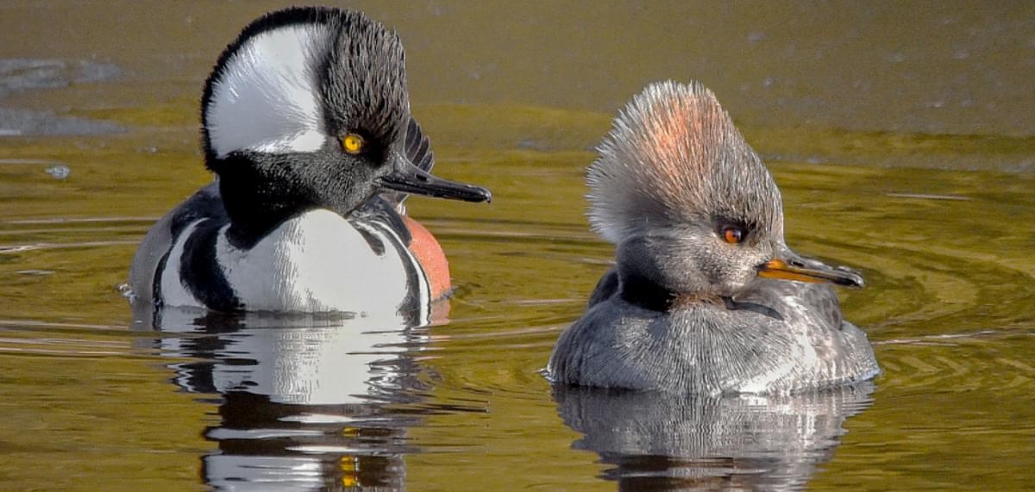
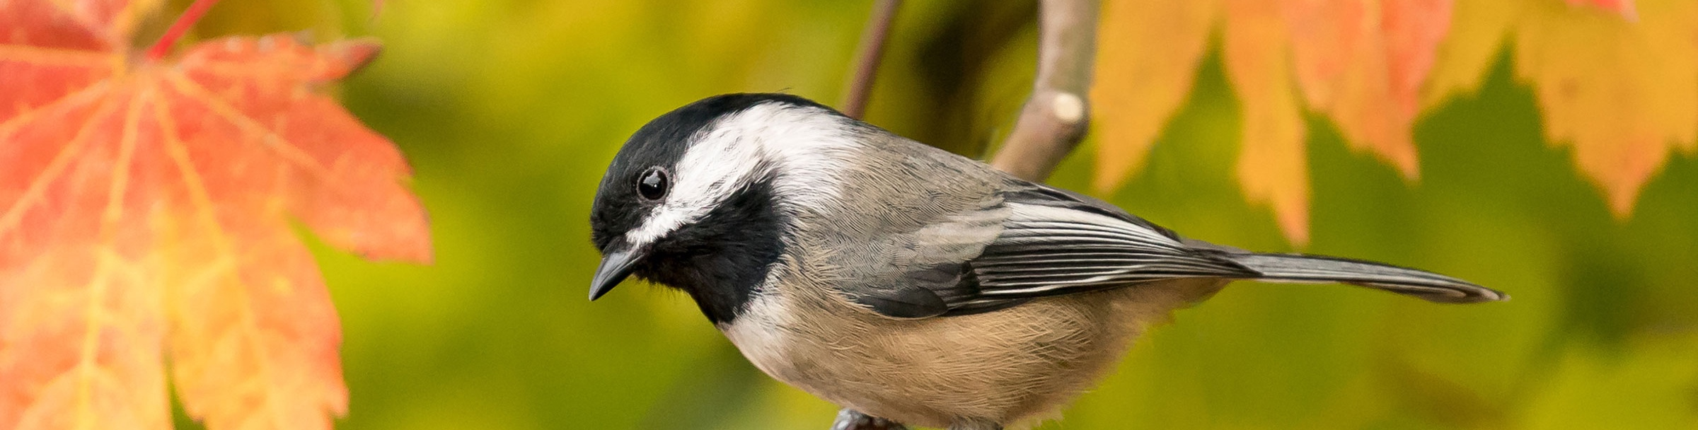
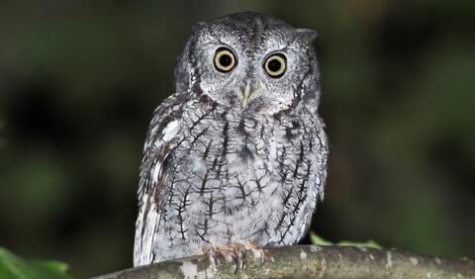
Let’s Save Some Birds!
Photo: Jason Major
Bird Safe Guelph School Outreach Programs
Grades 5 & 6
Photo: Mick Thompson
Photo: Dean Anderson

Slide 2

What are birds?
What are the 6 features that make a bird a bird?
Rock Pigeon
Art by Liz Clayton Fuller

Slide 3


What are birds?
What are the 6 features that make a bird a bird?
Feathers
Rock Pigeon
Art by Liz Clayton Fuller

Slide 4

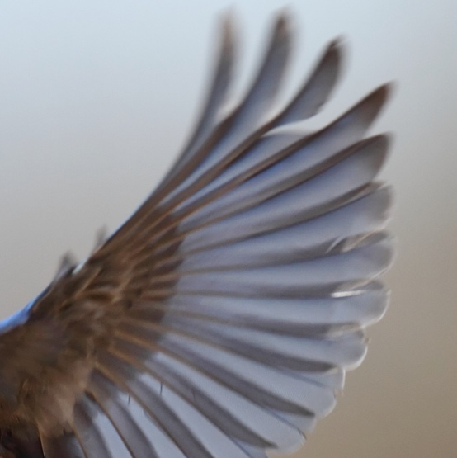
What are birds?
What are the 6 features that make a bird a bird?
Feathers
Wings
Rock Pigeon
Art by Liz Clayton Fuller

Slide 5
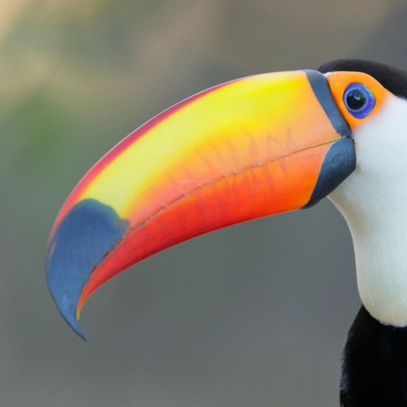

What are birds?
What are the 6 features that make a bird a bird?
Beaks
Feathers
Wings
Rock Pigeon
Art by Liz Clayton Fuller

Slide 6
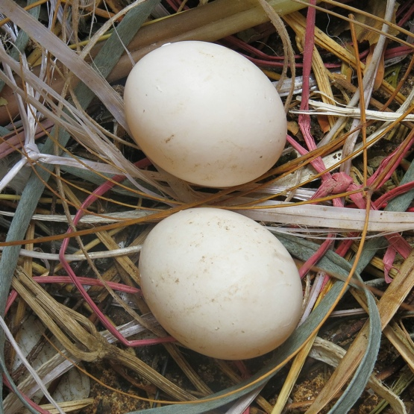
What are birds?
What are the 6 features that make a bird a bird?
Beaks
Feathers
Wings
4
Hard-shelled Eggs
Rock Pigeon
Art by Liz Clayton Fuller

Slide 7
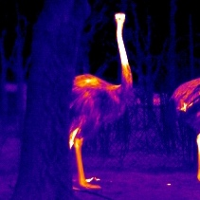

What are birds?
What are the 6 features that make a bird a bird?
Beaks
Feathers
Wings
4
Warm-blooded
Hard-shelled Eggs
Rock Pigeon
Art by Liz Clayton Fuller

Slide 8
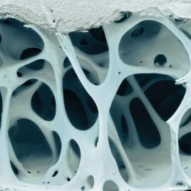
What are birds?
What are the 6 features that make a bird a bird?
Beaks
Feathers
Wings
4
Warm-blooded
6
Hard-shelled Eggs
Lightweight Bones
Rock Pigeon
Art by Liz Clayton Fuller

Slide 9
What are birds?
What are the 6 features that make a bird a bird?
Beaks
Feathers
Wings
4
Warm-blooded
6
Hard-shelled Eggs
For more bird anatomy check out:
All About Bird Anatomy
Lightweight Bones
Rock Pigeon
Art by Liz Clayton Fuller

Slide 10
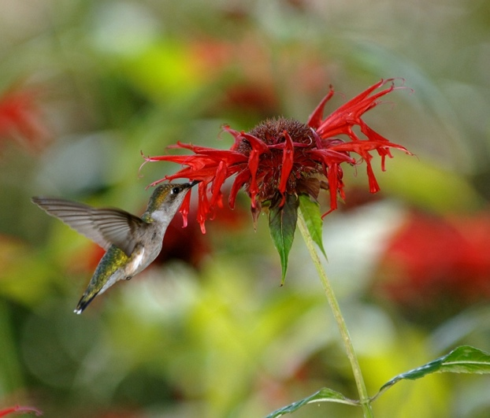
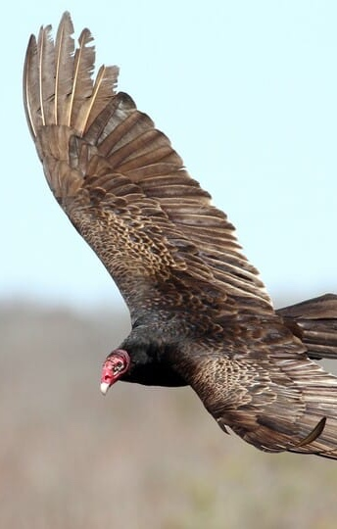
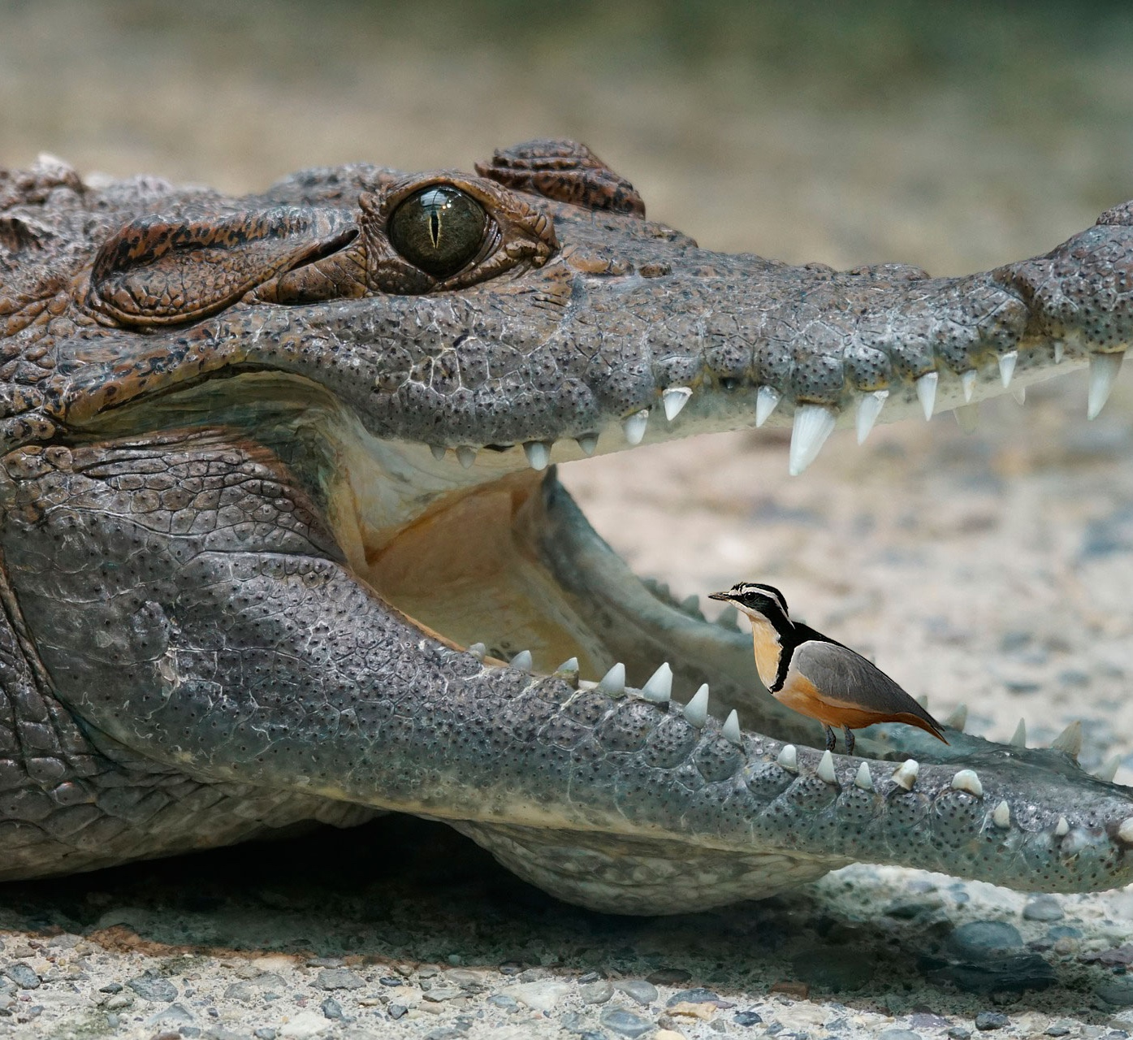
What are birds?
Ruby-throated Hummingbird
Photo: Joseph M. Schneid
Birds are important
Can you think of any reasons why?
Turkey Vulture
Photo: Evan Lipton
Egyptian Plover
https://smallscience.hbcse.tifr.res.in/crocodile-and-the-plover-bird/

Slide 11
What are birds?
Ruby-throated Hummingbird
Photo: Joseph M. Schneid
Birds are important
Can you think of any reasons why?
Ecologically Important
Pollination
  Ruby-throated Hummingbird
Scavengers
  Turkey Vulture
Interactions with other species
  Egyptian Plover and Nile Crocodile
Turkey Vulture
Photo: Evan Lipton
Egyptian Plover
https://smallscience.hbcse.tifr.res.in/crocodile-and-the-plover-bird/

Slide 12
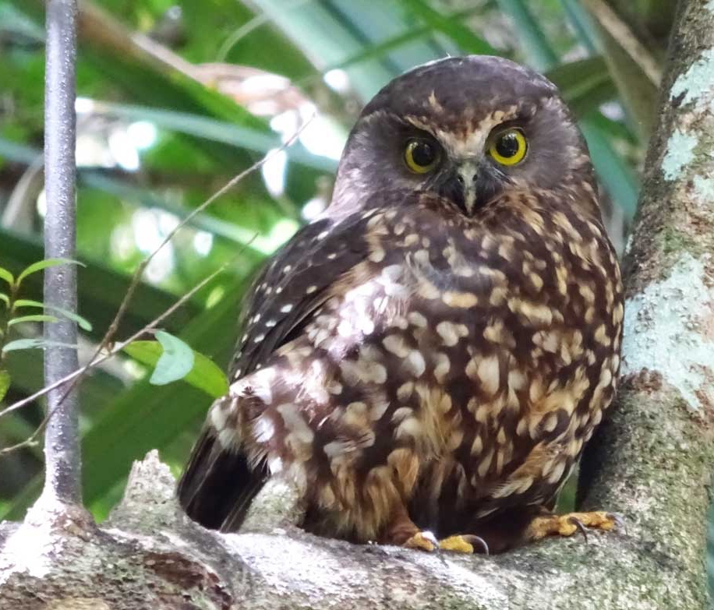
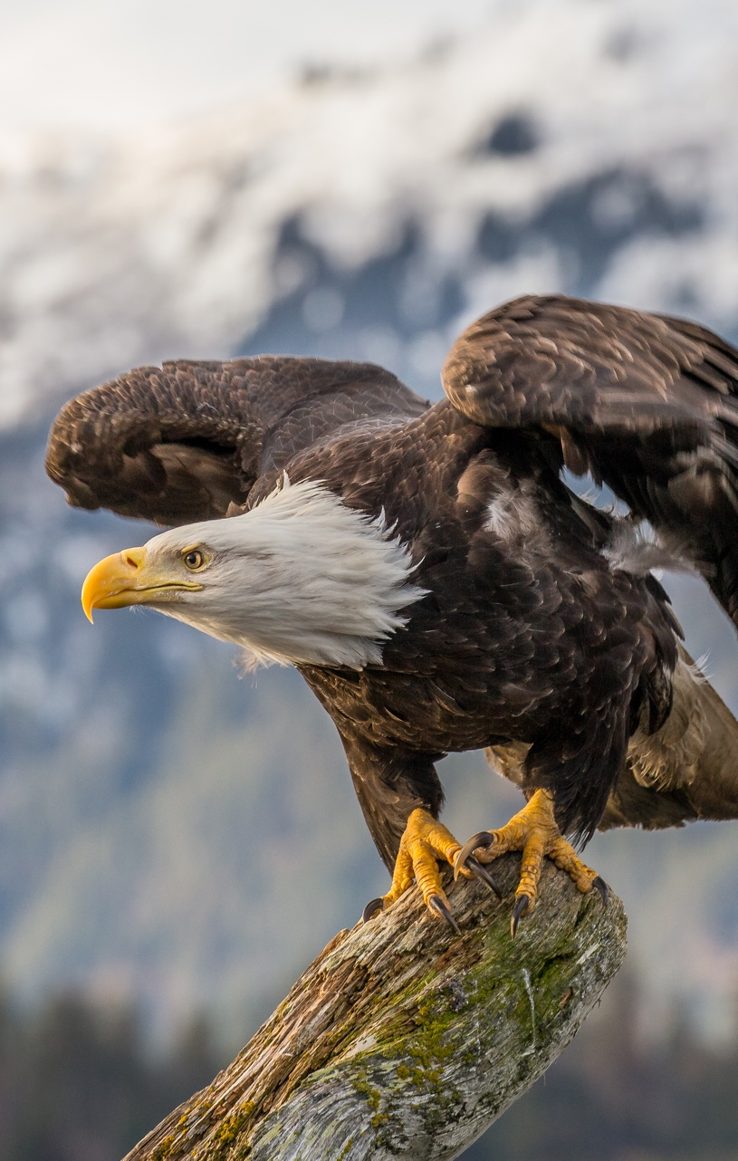
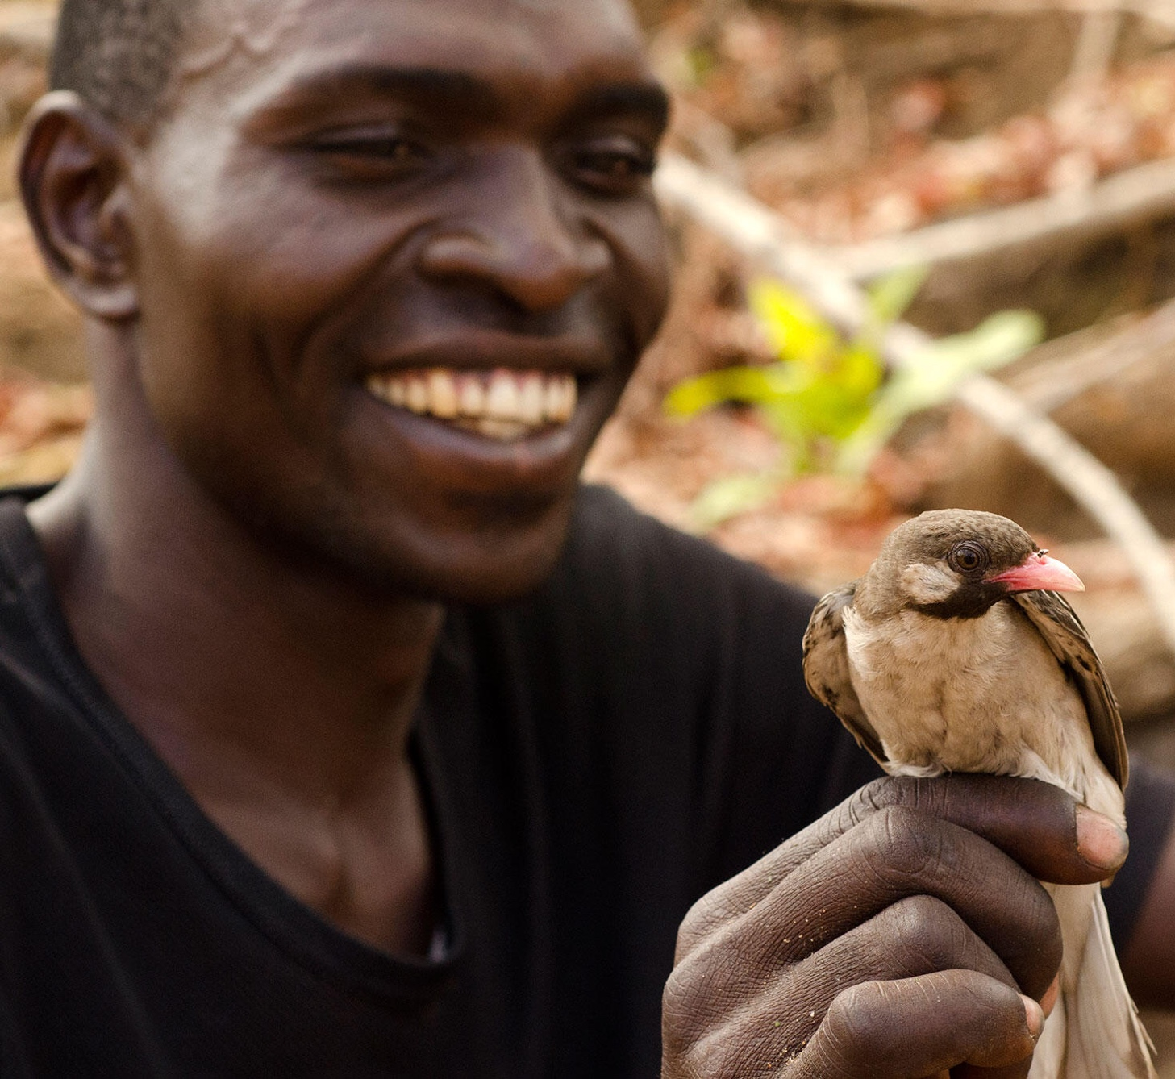
What are birds?
Ruru
Photo: Julie Mudge
Birds are important
Can you think of any reasons why?
Culturally Important
Ruru (Morepork) and Maori people
Bald Eagle and the United States
Greater Honeyguide and the Yao people
Bald Eagle
Photo: Andy Morffew
Greater Honeyguide
Photo: Claire Spottiswoode

Slide 13
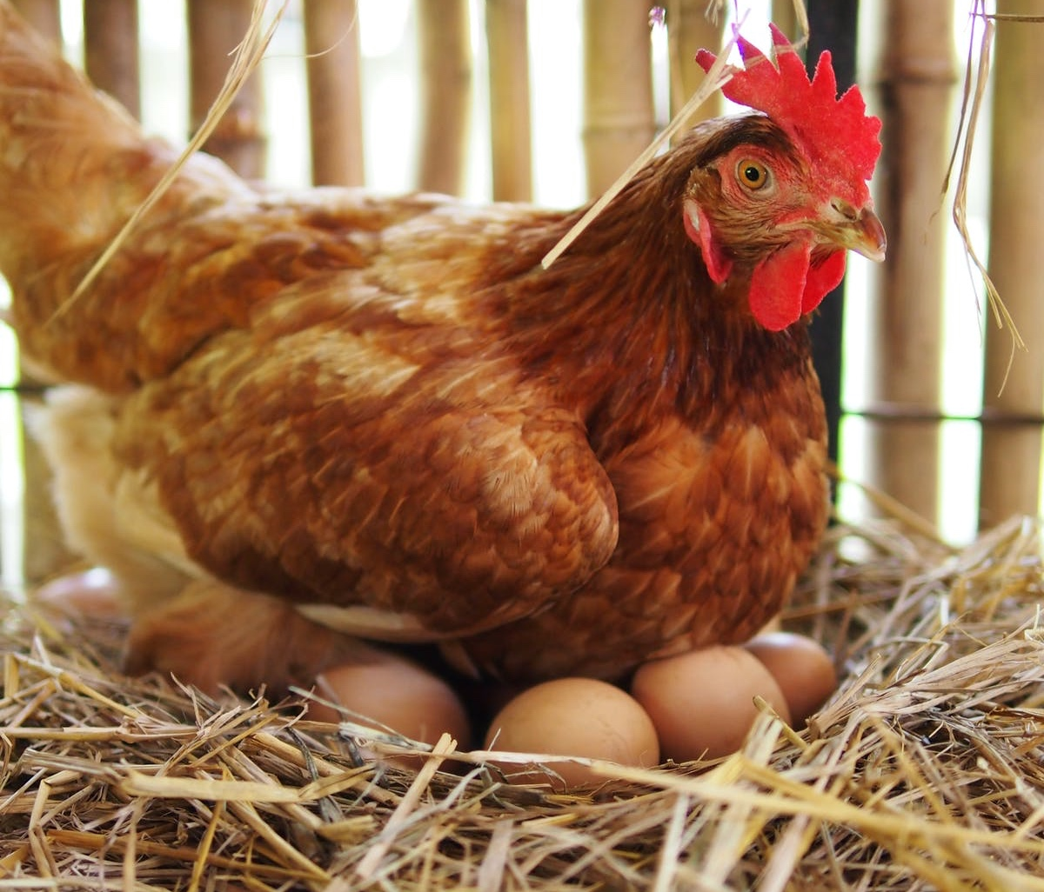

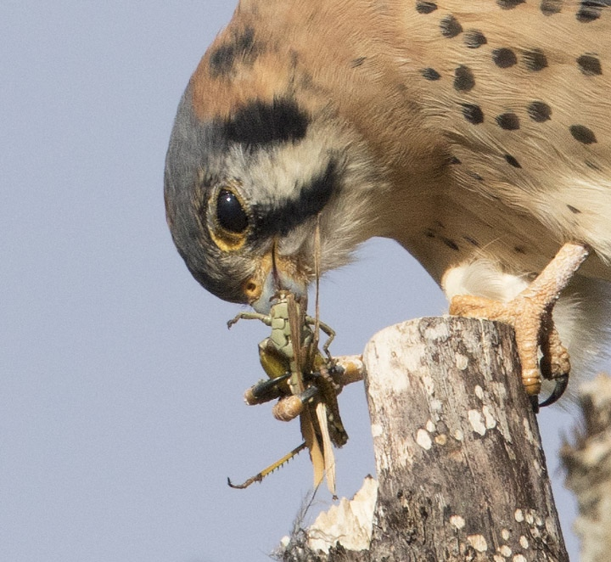
What are birds?
Chicken
https://starmilling.com/eggs-tasting-a-little-fishy/
Birds are important
Can you think of any reasons why?
Economically Important
Our Food
  Chicken eggs and meat
Agricultural Pest Control
  American Kestrel
Recreation
  Birdwatching!
Birdwatching!
Photo: CBC/Francis Ferland
American Kestrel
Photo: Ron Dudley

Slide 14
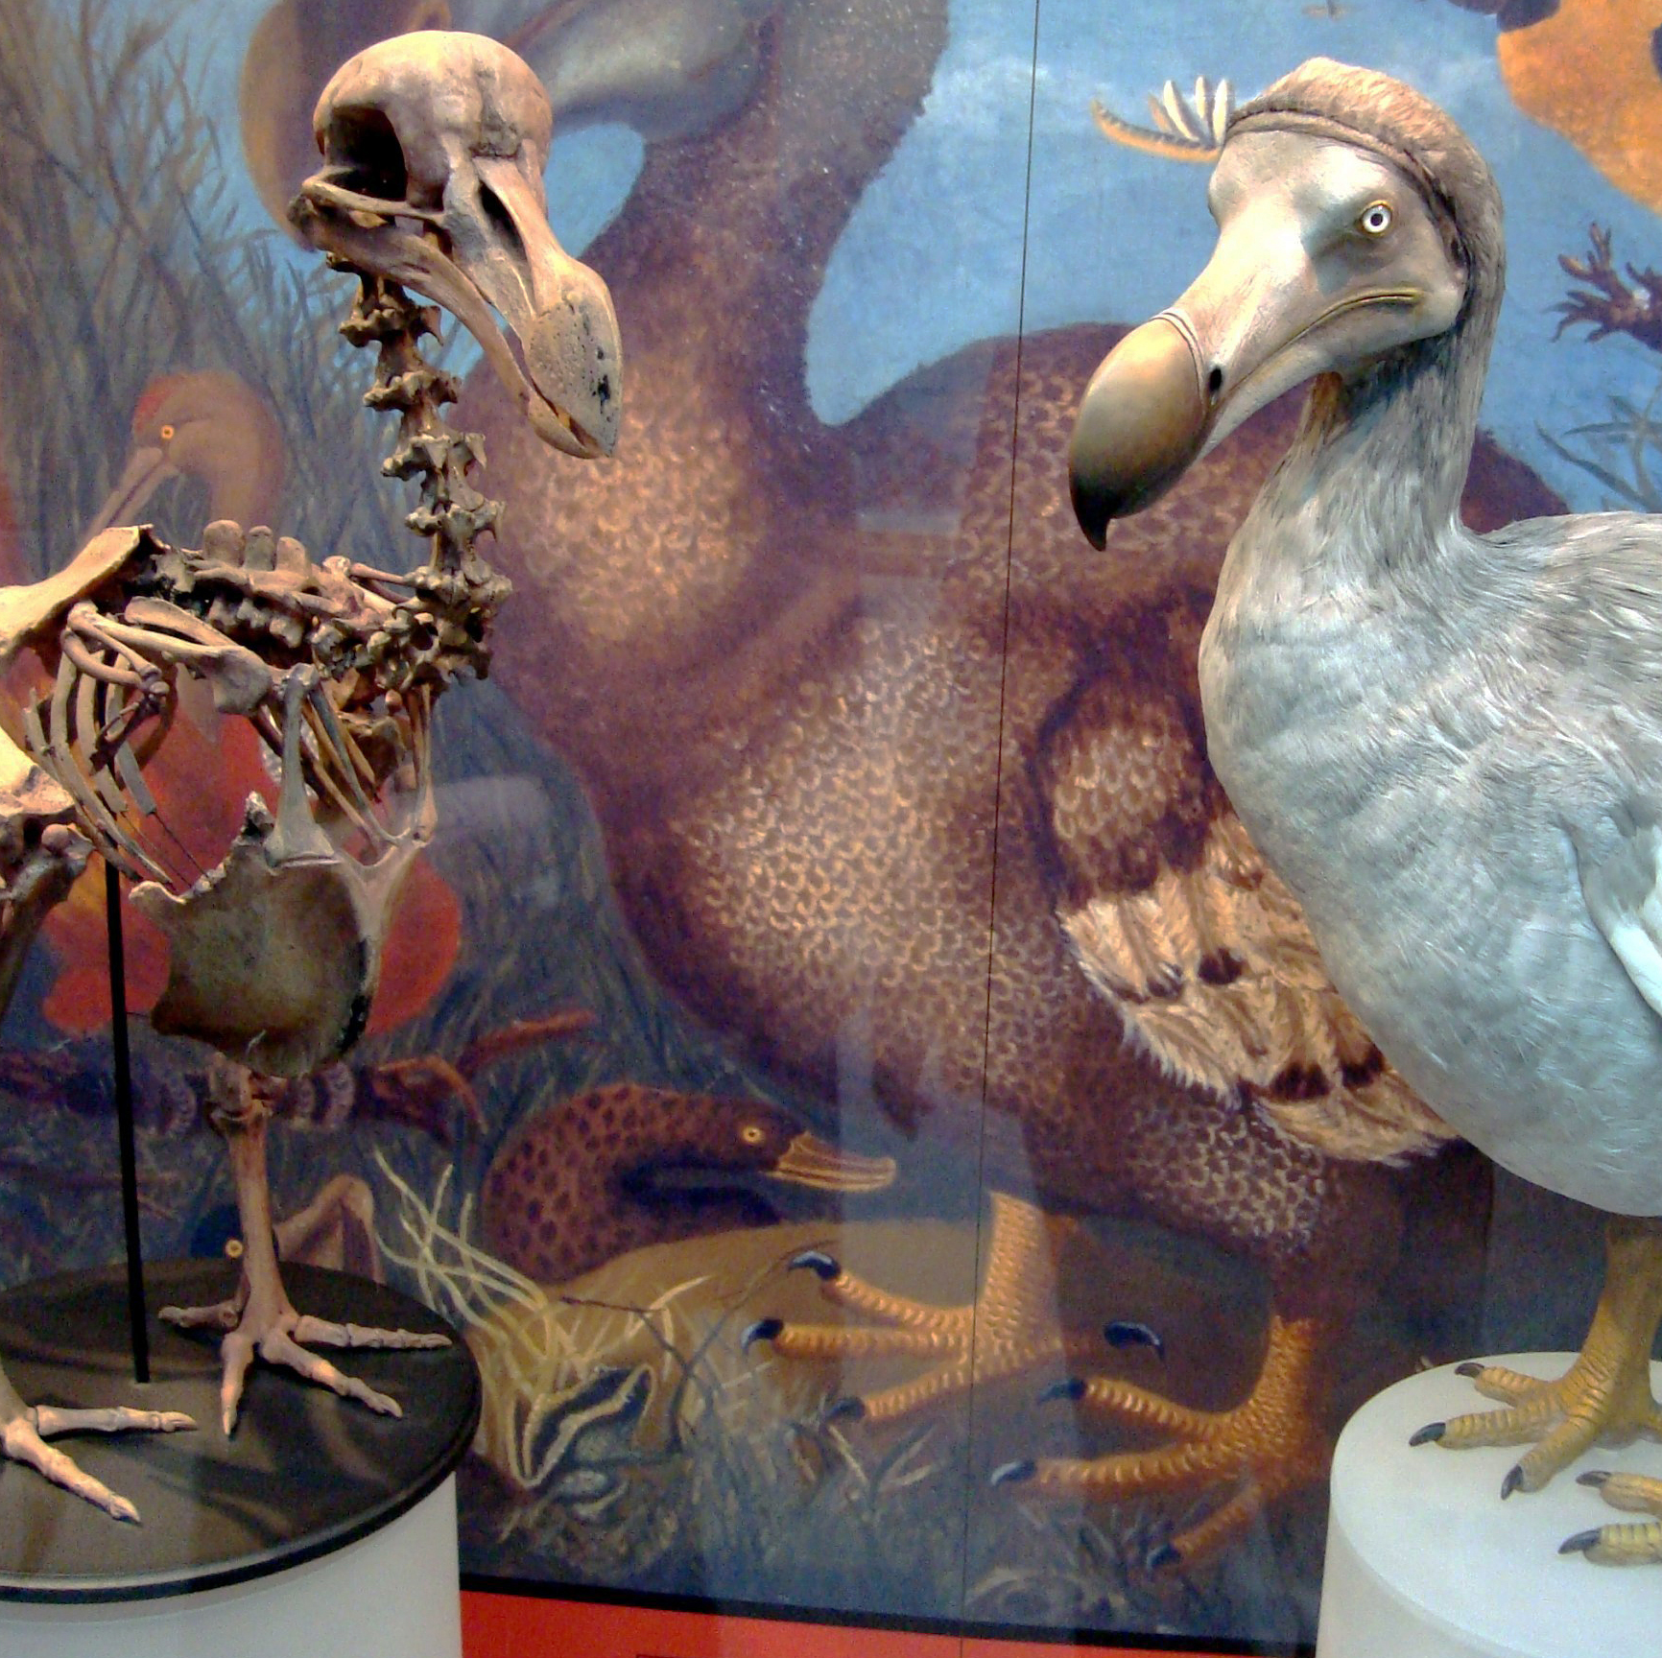
What’s happening to the birds?
Many bird species are facing extinction. Does anyone know what extinction means?
Dodo
Photo: BazzaDaRambler - Oxford University Museum of Natural History

Slide 15
What’s happening to the birds?
Many bird species are facing extinction. Does anyone know what extinction means?
  When a species disappears from the earth forever
Dodo
Photo: BazzaDaRambler - Oxford University Museum of Natural History

Slide 16
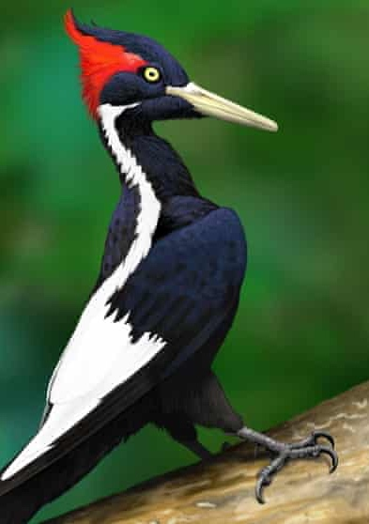
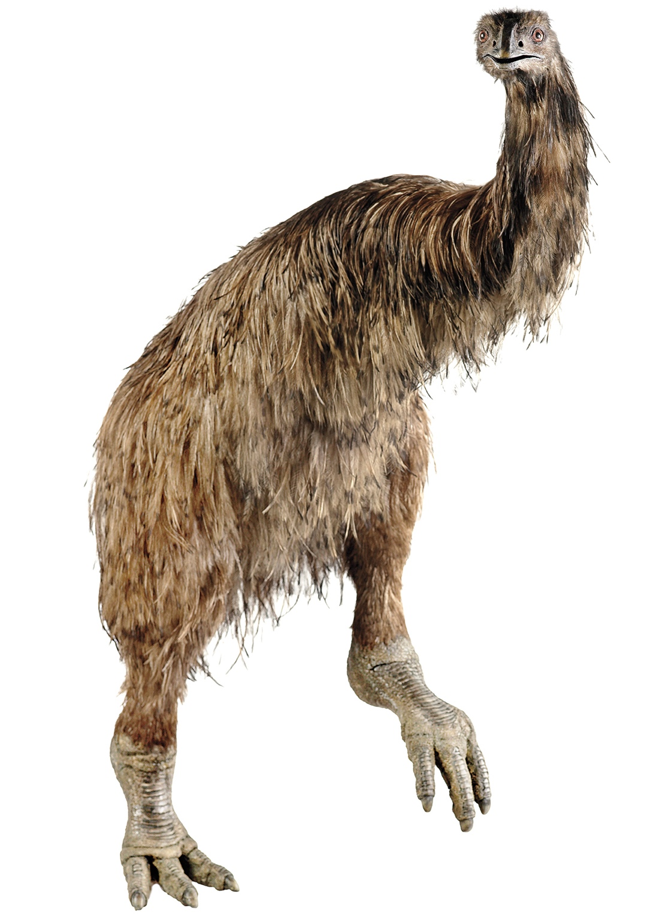
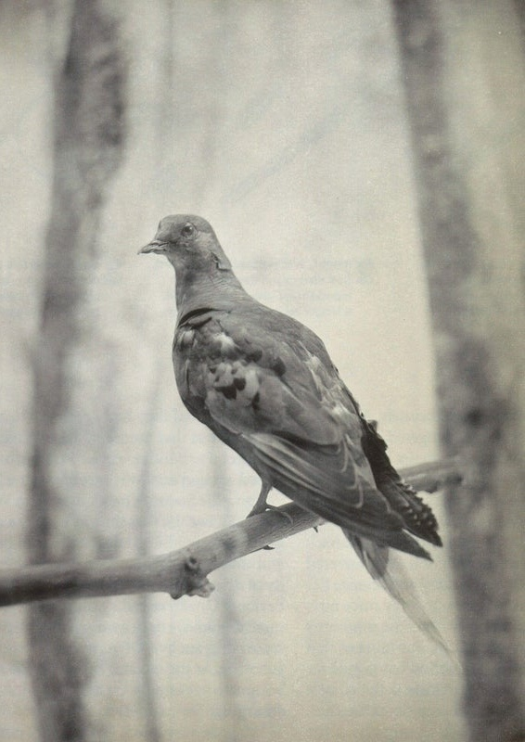
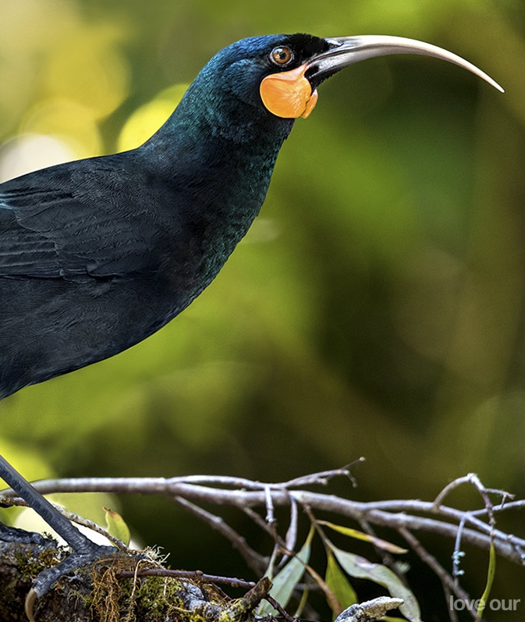
Ivory-billed woodpecker
Photo: Tomasz Cofta/BirdLife Internatio/PA
Coastal Moa
Photo: TE PAPA/CC BY-NC-ND
Passenger Pigeon
Photo: Alamy
Huia
Image © John and Melody Anderson
Over 150 bird species have gone extinct in the last 500 years

Slide 17
Ivory-billed woodpecker
Photo: Tomasz Cofta/BirdLife Internatio/PA
Coastal Moa
Photo: TE PAPA/CC BY-NC-ND
Passenger Pigeon
Photo: Alamy
Huia
Image © John and Melody Anderson
Over 150 bird species have gone extinct in the last 500 years
  Largely due to human activity
  What do you think we might be doing that causes this?
  How can we help?

Slide 18
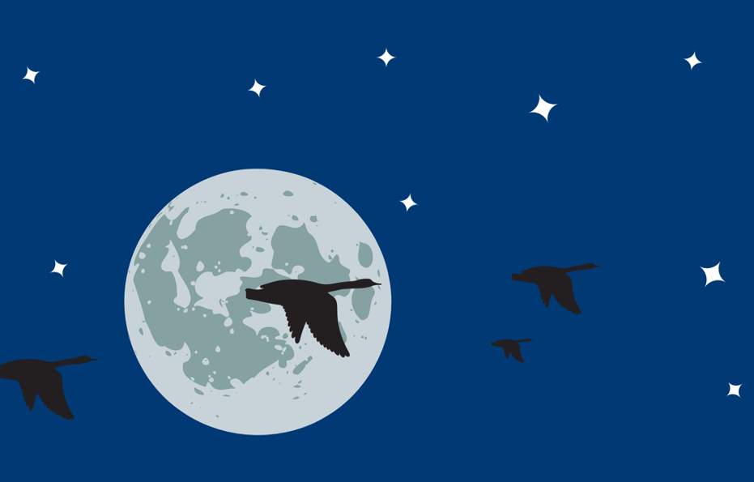

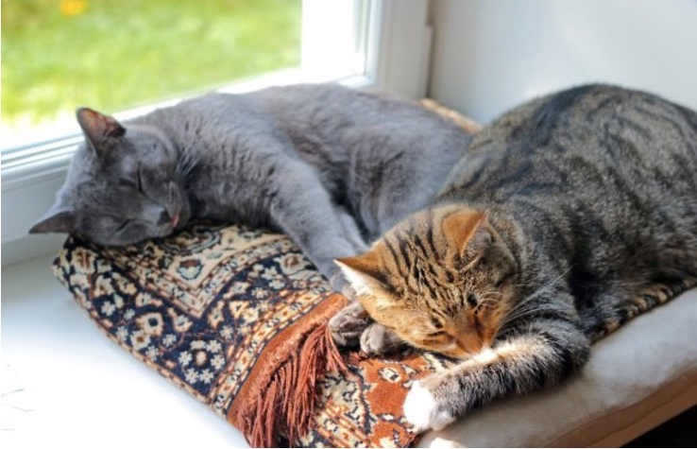
How can you help birds?
Bird-proof your windows!
  Prevents window collisions
  Visit FLAP to find out more
Turn off lights at night!
  Helps migrating birds
  Visit the Lights Out Program to learn how
Don’t let your cat outside!
  Cats are excellent hunters and love to hunt birds
https://blog.nwf.org/2017/09/11-tips-to-keep-your-indoor-cat-happy/

Slide 19
How can you help birds?
Bird-proof your windows!
  Prevents window collisions
  Visit FLAP to find out more
Turn off lights at night!
  Helps migrating birds
  Visit the Lights Out Program to learn how
Don’t let your cat outside!
  Cats are excellent hunters and love to hunt birds
https://blog.nwf.org/2017/09/11-tips-to-keep-your-indoor-cat-happy/

Slide 20
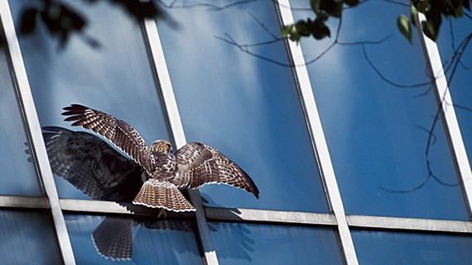
Window Collisions
How many birds do you think die from colliding with windows?
https://www.nwf.org/Magazines/National-Wildlife/2014/OctNov/Animals/Bird-Safe-Windows

Slide 21
Window Collisions
How many birds do you think die from colliding with windows?
  100 million to 1 billion birds die every year in North America due to window collisions!
https://www.nwf.org/Magazines/National-Wildlife/2014/OctNov/Animals/Bird-Safe-Windows

Slide 22
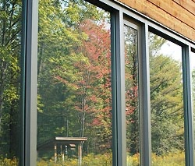
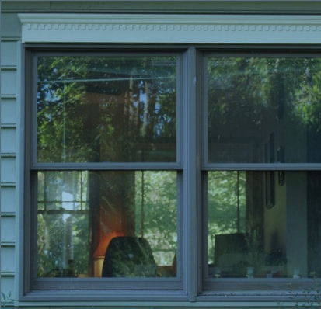
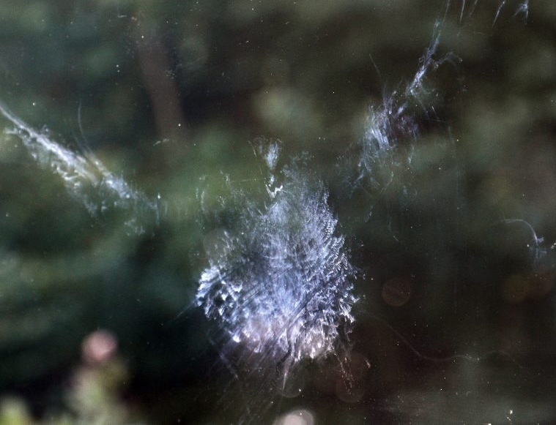
Window Collisions
Why does this happen?
Photo: Susan Spear/Cornell Lab.
Photo: CC Stuart Anthony
Photo: Peter Saenger

Slide 23
Window Collisions
Why does this happen?
  Reflections
  Can see through to the other side
Photo: Susan Spear/Cornell Lab.
Photo: CC Stuart Anthony
Photo: Peter Saenger

Slide 24
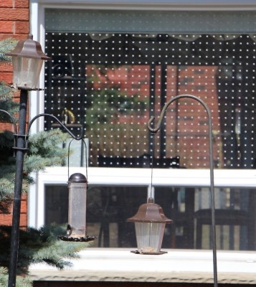
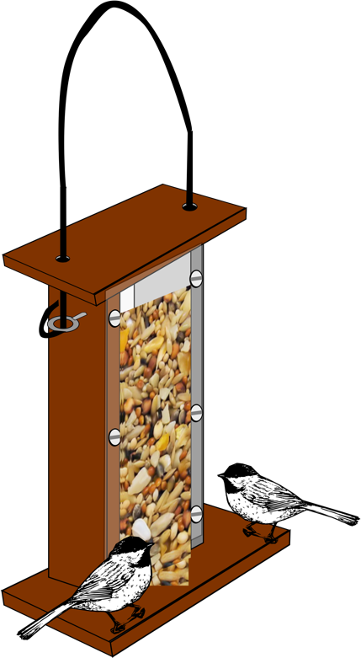

What can we do?
Move your birdfeeder
Within 0.5 meters of your window
  Prevents birds from becoming seriously injured when flying away from feeder
0.5 Meters
Photo: FLAP Canada

Slide 25
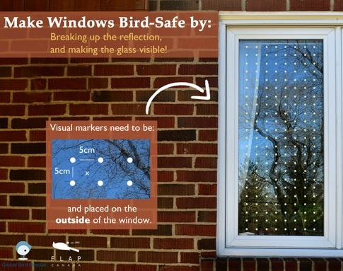
What can we do?
Follow some of these FLAP guidelines to birdproof your windows!
High-contrast markings on the outside of your windows
  ≥ 6 mm in diameter
  < 5 cm apart
  Cover the entire surface of the window

Slide 26
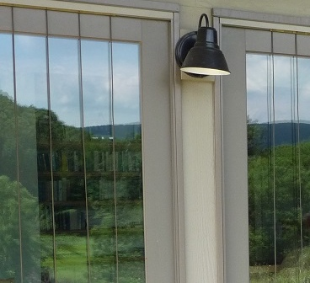
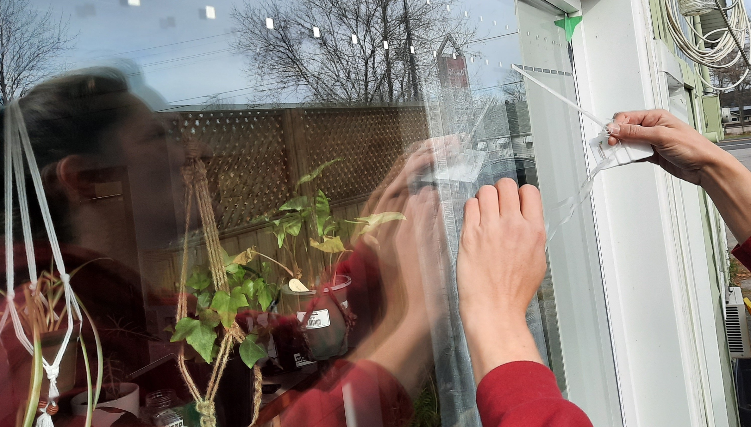
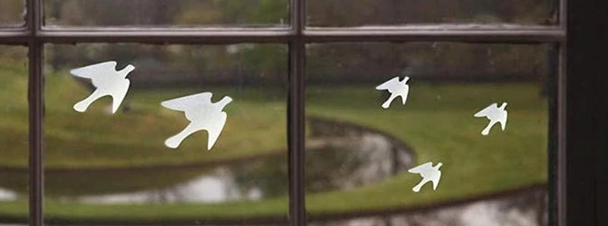
Feather Friendly DIY Tape
https://www.featherfriendly.com/residential-gallery?hsLang=en
Hanging String
https://www.aliexpress.com/i/1005001586330174.html
Adhesive Decals
Photo: Jeff Acopian

Slide 27
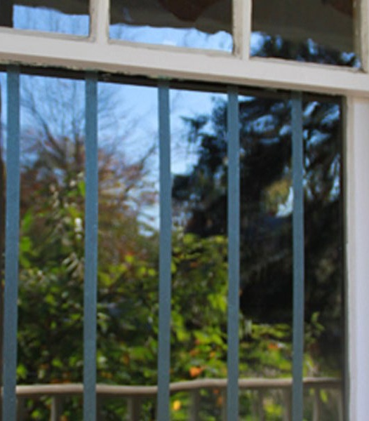
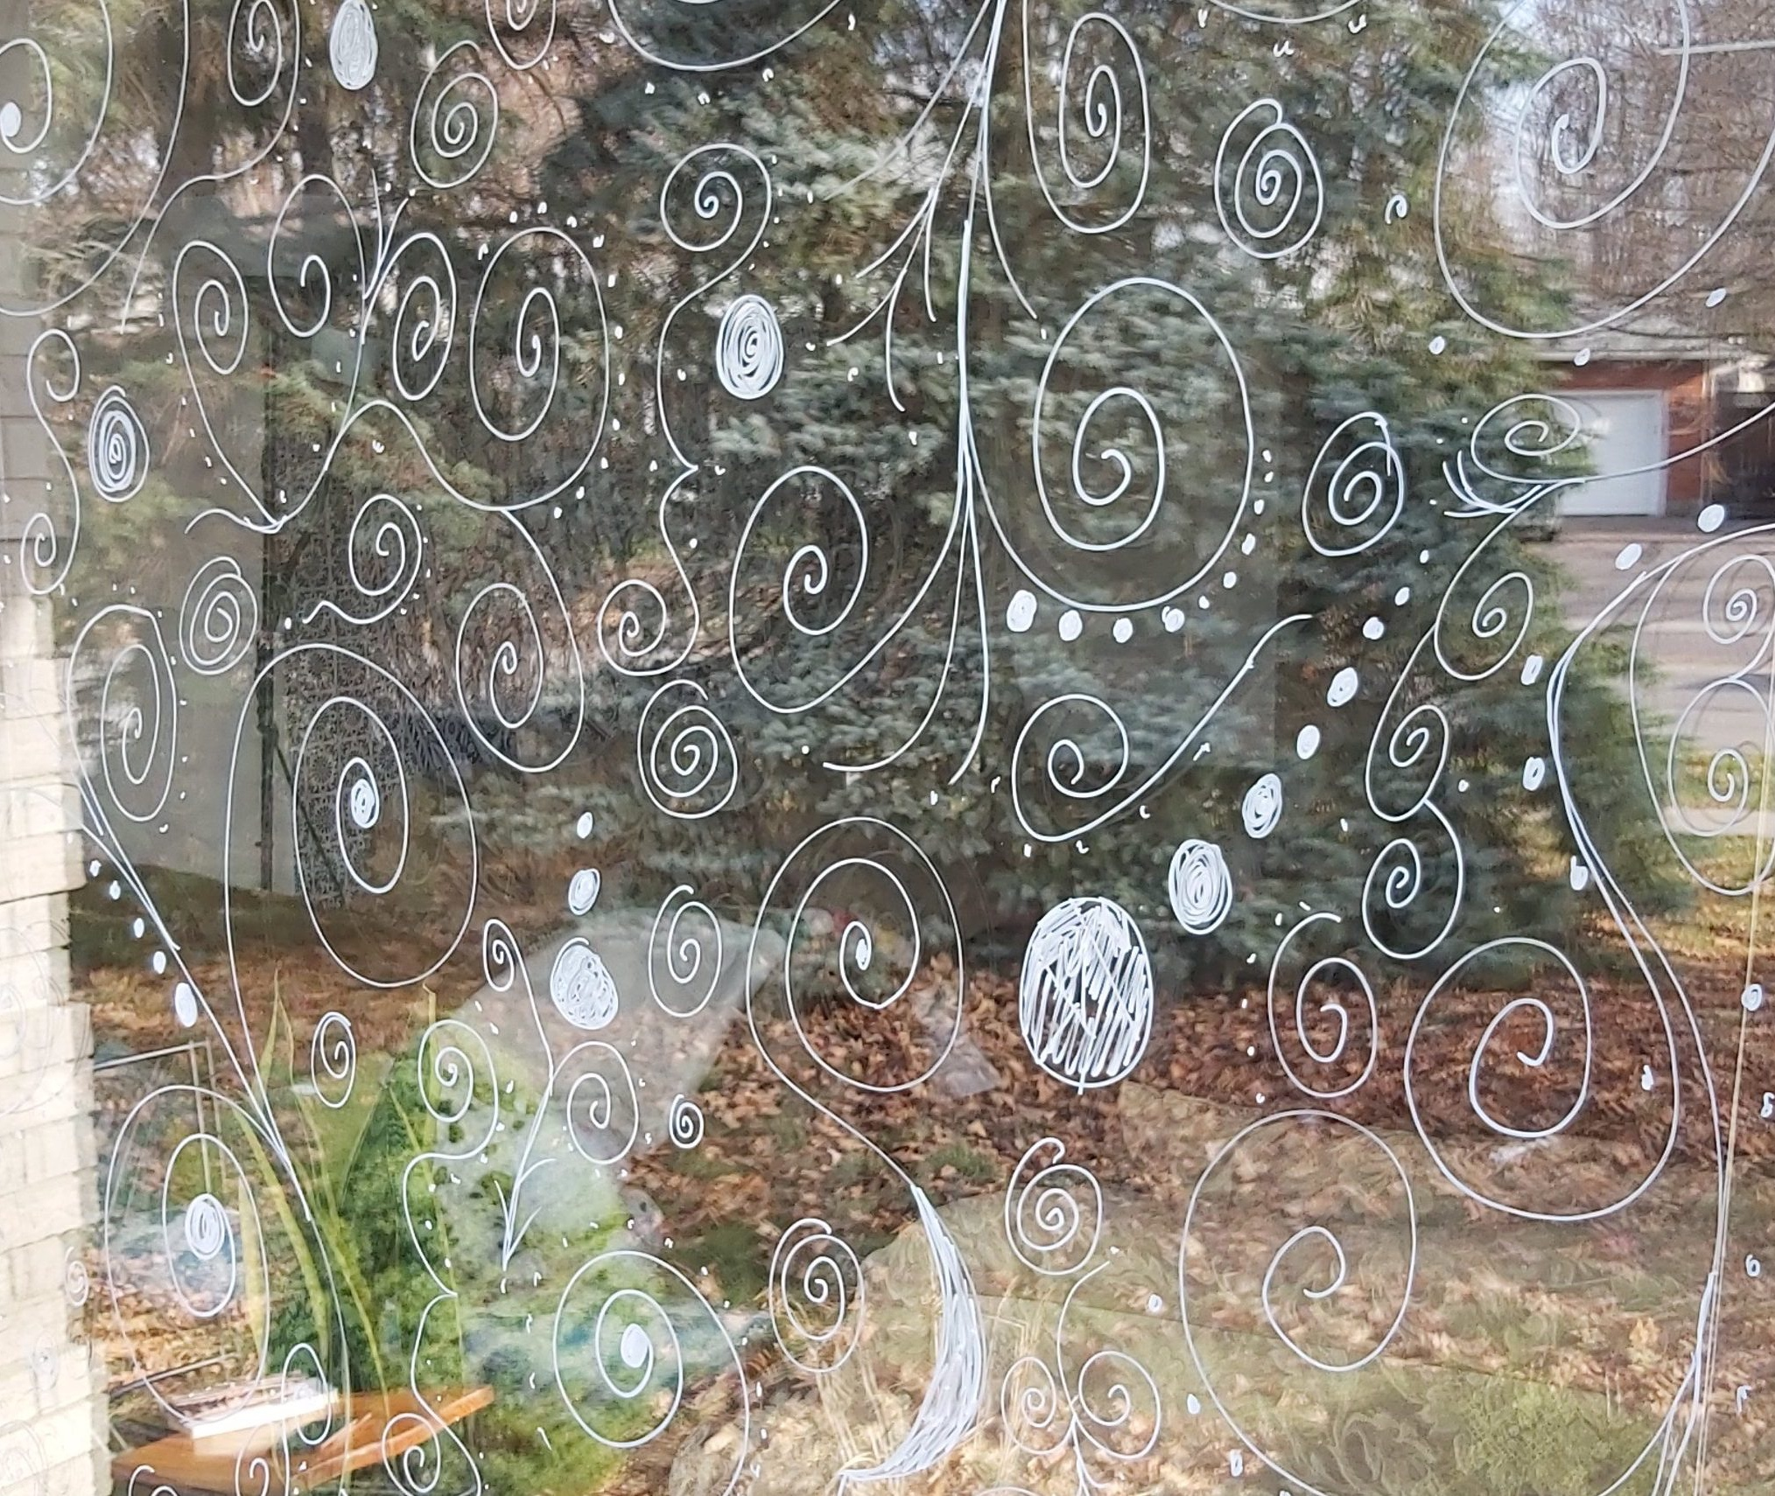
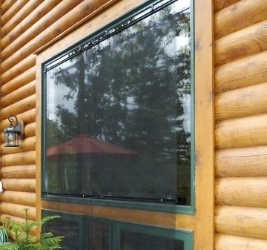
Photo: ABC Bird Tape
Exterior Window Screens
Photo: Dr. Ellen Rudolph
Make your own design with Paint Pens or a Bar of Soap!
Bird Tape

Slide 28
How can you help birds?
Bird-proof your windows!
  Prevents window collisions
  Visit FLAP to find out more
Turn off lights at night!
  Helps migrating birds
  Visit the Lights Out Program to learn how
Don’t let your cat outside!
  Cats are excellent hunters and love to hunt birds
https://blog.nwf.org/2017/09/11-tips-to-keep-your-indoor-cat-happy/

Slide 29
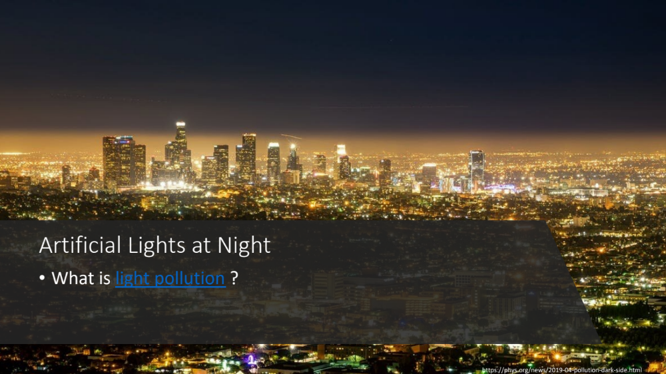

Slide 30
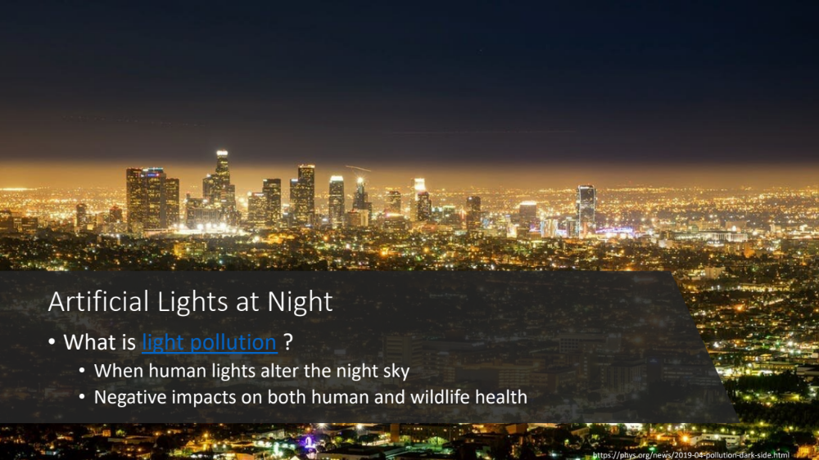

Slide 31
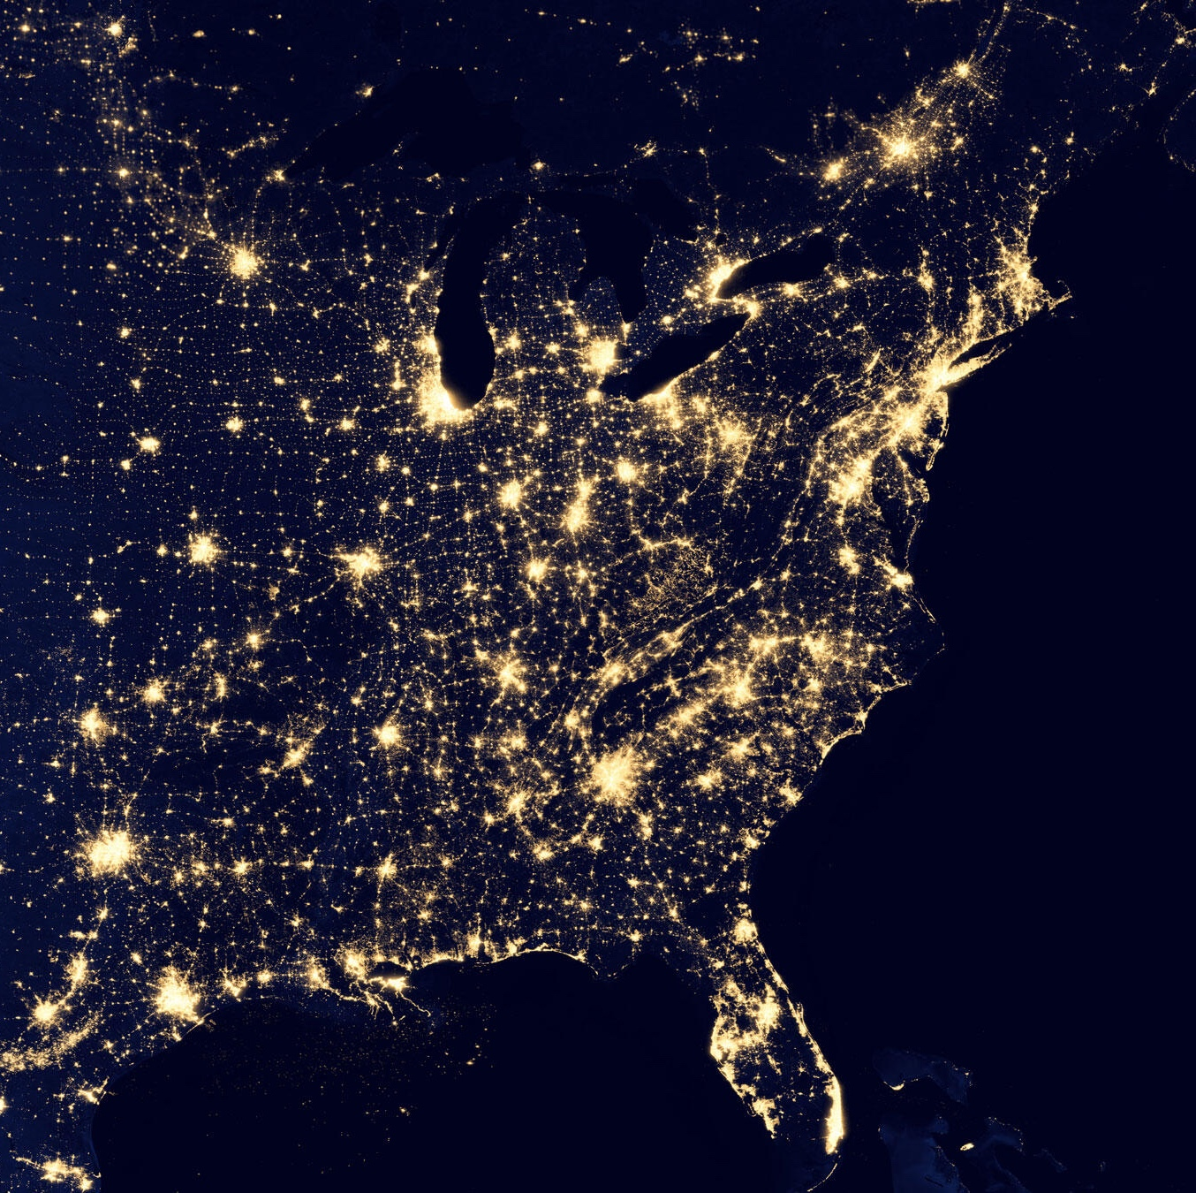
Artificial Lights at Night
80% of Migratory Birds in North America travel at night
How do you think our lights may impact birds?
https://www.audubon.org/lights-out-program

Slide 32
Artificial Lights at Night
80% of Migratory Birds in North America travel at night
How do you think our lights may impact birds?
  Disorientation
  Attraction towards cities and away from important stopover spots
  Wasting energy when lost
https://www.audubon.org/lights-out-program

Slide 33
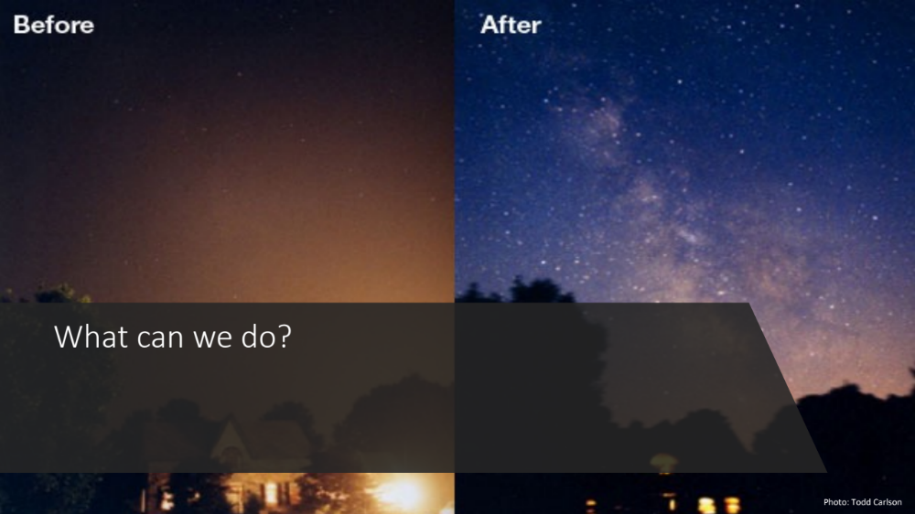

Slide 34
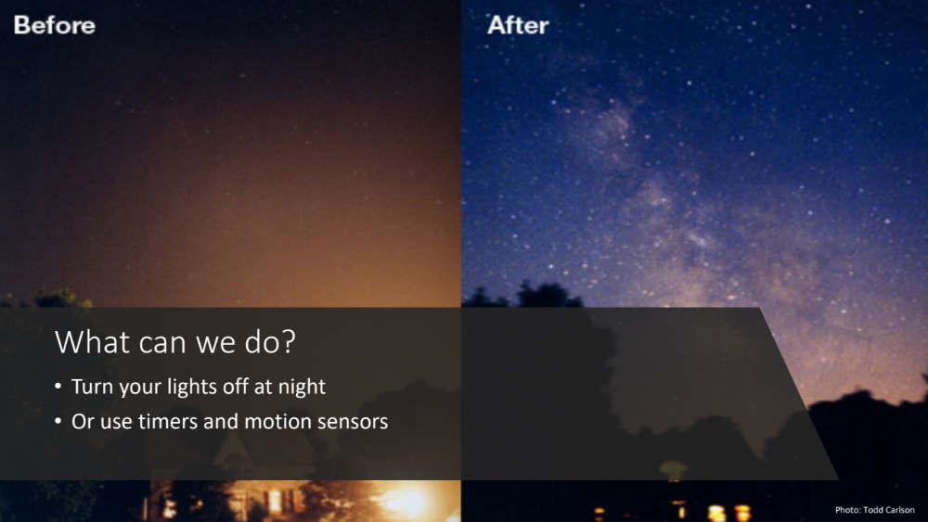

Slide 35
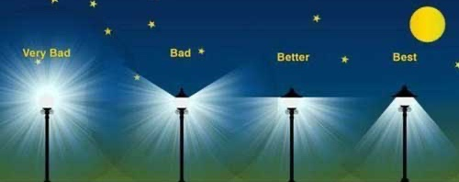
What can we do?
https://nightsky.jpl.nasa.gov/news-display.cfm?News_ID=939
Shielding to direct light away from the sky
Reduced brightness bulbs outside

Slide 36
How can you help birds?
Bird-proof your windows!
  Prevents window collisions
  Visit FLAP to find out more
Turn off lights at night!
  Helps migrating birds
  Visit the Lights Out Program to learn how
Don’t let your cat outside!
  Cats are excellent hunters and love to hunt birds
https://blog.nwf.org/2017/09/11-tips-to-keep-your-indoor-cat-happy/

Slide 37
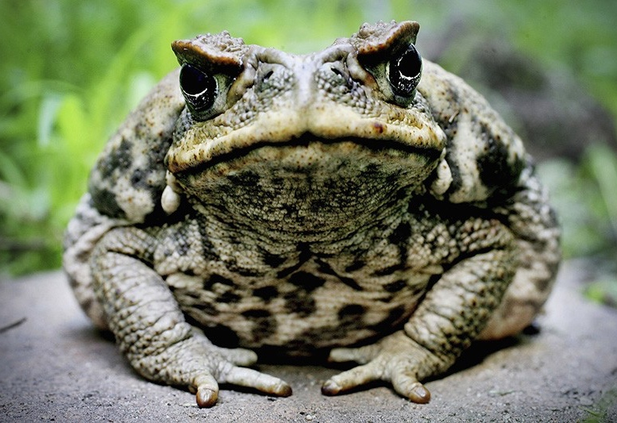
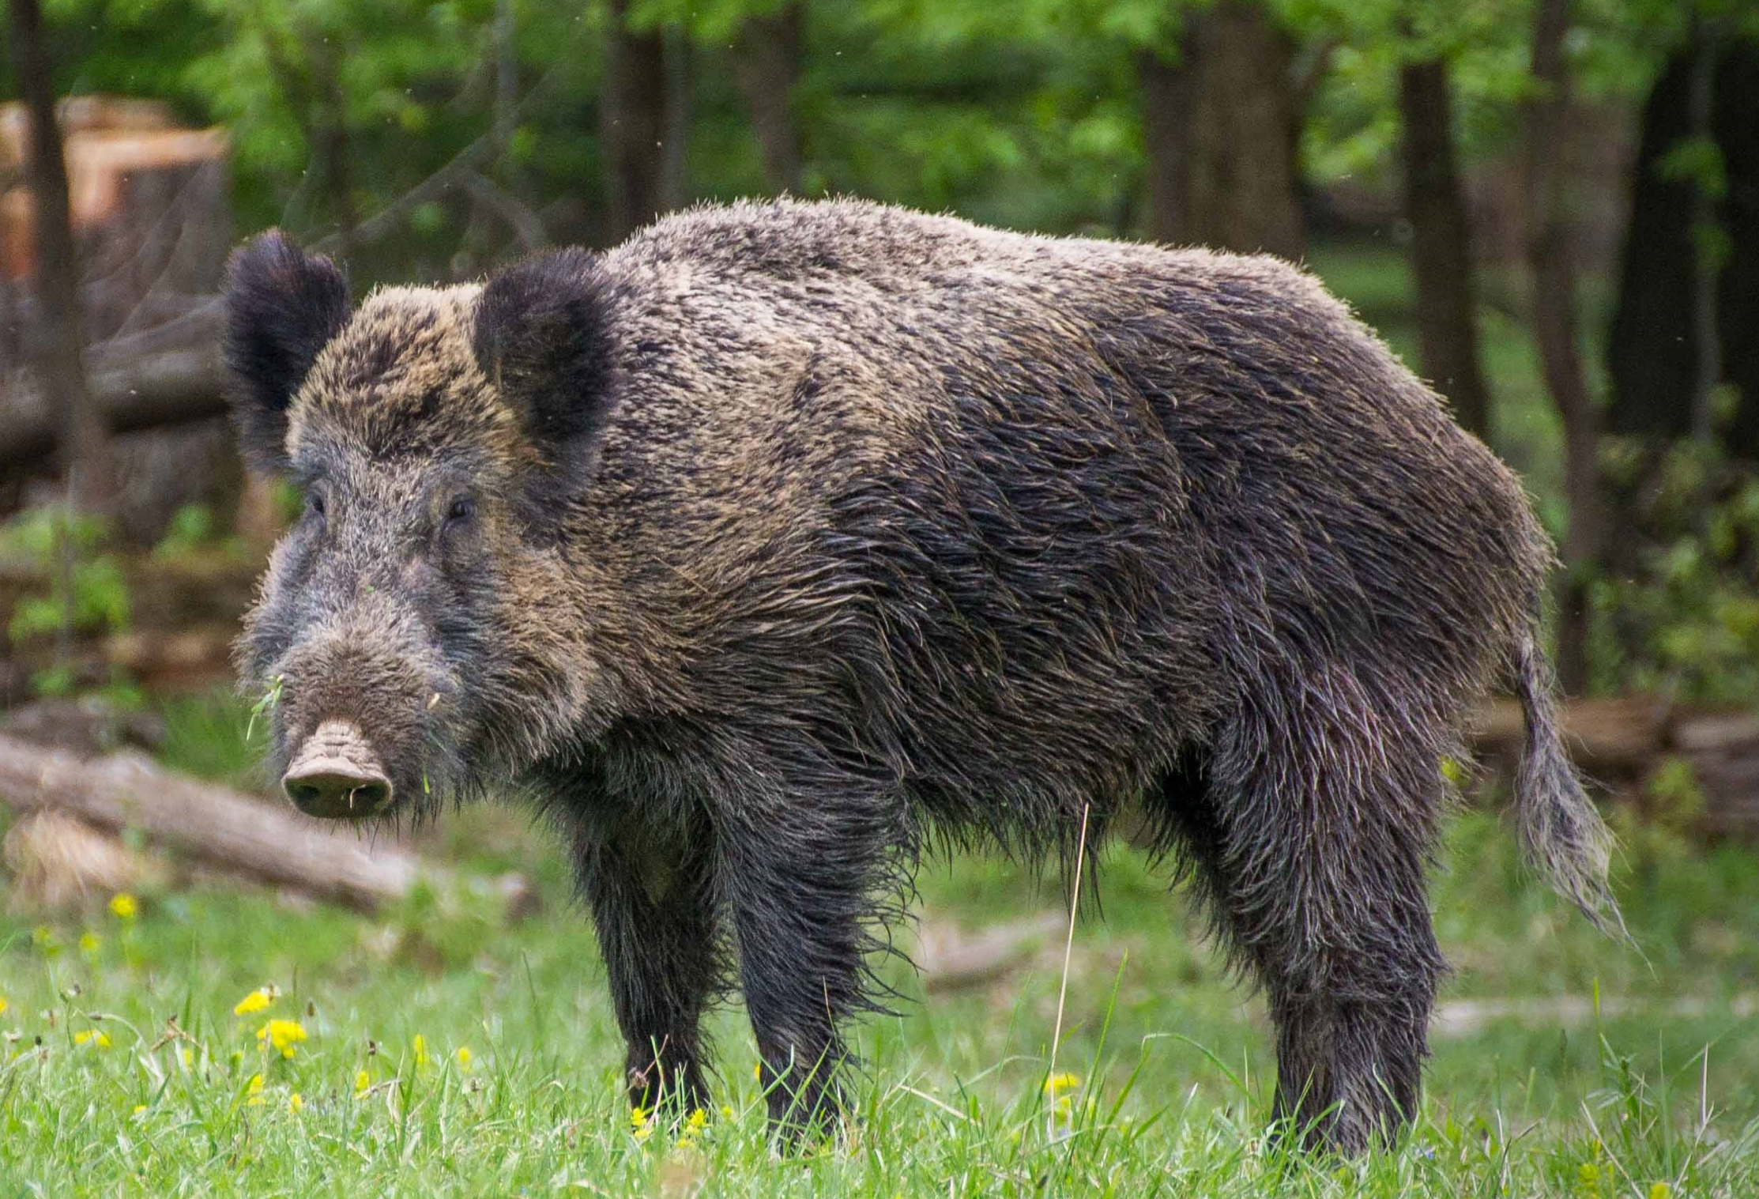
Biological Invasions
Do you know what an invasive species is?
  A species that has been introduced by humans and causes harm to ecosystems
Cane Toad
Photo: Ian Waldie/Getty
Wild Boar
Photo: Valentin Panzirsch

Slide 38
Biological Invasions
Do you know what an invasive species is?
  A species that has been introduced by humans and causes harm to ecosystems
Cane Toad
Photo: Ian Waldie/Getty
Wild Boar
Photo: Valentin Panzirsch

Slide 39
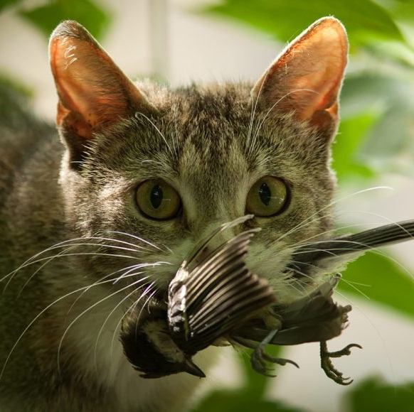
Biological Invasions: Cats
How many birds do you think cats kill every year?
Ornitolog82/iStock/Getty Images Plus

Slide 40
Biological Invasions: Cats
How many birds do you think cats kill every year?
  Up to 350 Million in Canada every year!
  Close to 4 BILLION in the United States every year!
Ornitolog82/iStock/Getty Images Plus

Slide 41
Biological Invasions: Cats
How many birds do you think cats kill every year?
  Up to 350 Million in Canada every year!
  Close to 4 BILLION in the United States every year!
Domestic cats have contributed to 63 species going extinct
Ornitolog82/iStock/Getty Images Plus

Slide 42
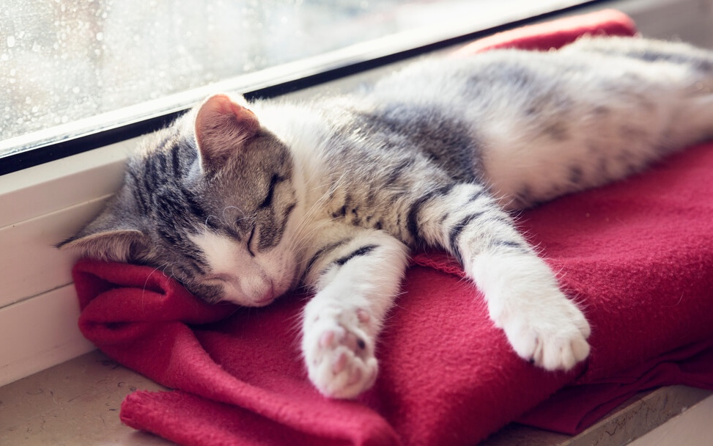
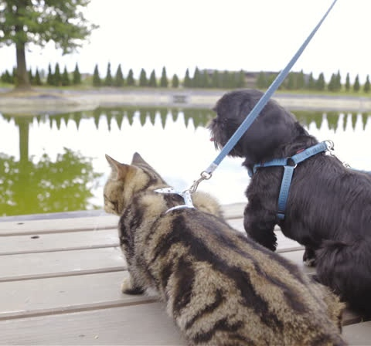
What can you do?
https://www.purina.co.uk/articles/cats/behaviour/common-questions/cat-sleeping-habits
Photo: Shutterstock
How do you think we can help?
  Don’t let your cat outside
  Walk your dog or cat on a leash

Slide 43
What can you do?
https://www.purina.co.uk/articles/cats/behaviour/common-questions/cat-sleeping-habits
Photo: Shutterstock
How do you think we can help?
  Don’t let your cat outside
  Walk your dog or cat on a leash

Slide 44

How can you help birds?
Bird-proof your windows!
Turn off lights at night!
Don’t let your cat outside!
Check out Bird Safe Guelph to learn more and get involved!
https://blog.nwf.org/2017/09/11-tips-to-keep-your-indoor-cat-happy/

Slide 45
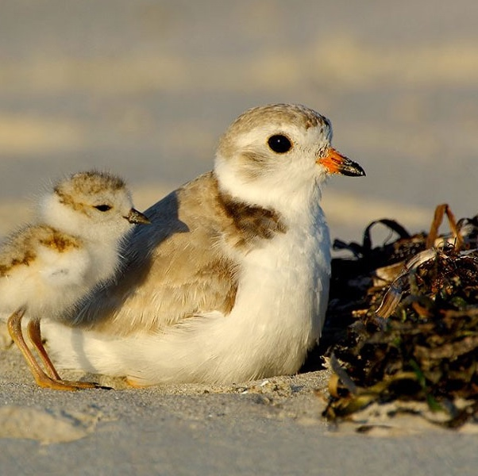
Piping Plover Game!
Your class is now a nesting colony of Piping Plovers!
You have a safe area where no dogs are aloud, but you all must venture out to find some yummy worms before the end of the season
Don’t let the dogs catch you before you collect 3 worms!
https://wildlifepreservation.ca/piping-plover/

Slide 46
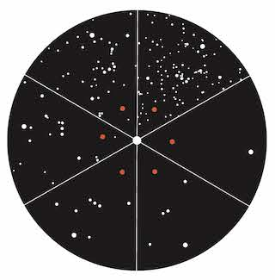
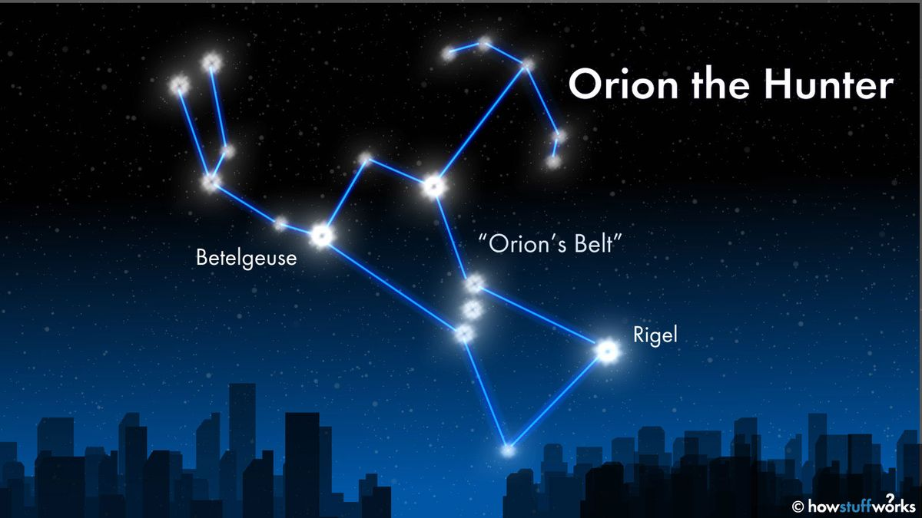
Dark Sky Wheel
NASA JPL: Big Astronomy Toolkit
5
6
Take this handout home and try to find the constellation Orion tonight!
Write down which section of the wheel your sky looks like
Share your score and what you saw in class the next day
4
1
3
2

Slide 47

Let’s watch some birds!
Follow the link to the Cornell Lab of Ornithology’s Bird Cams to watch live video of birds all around the world!

