Slide 1

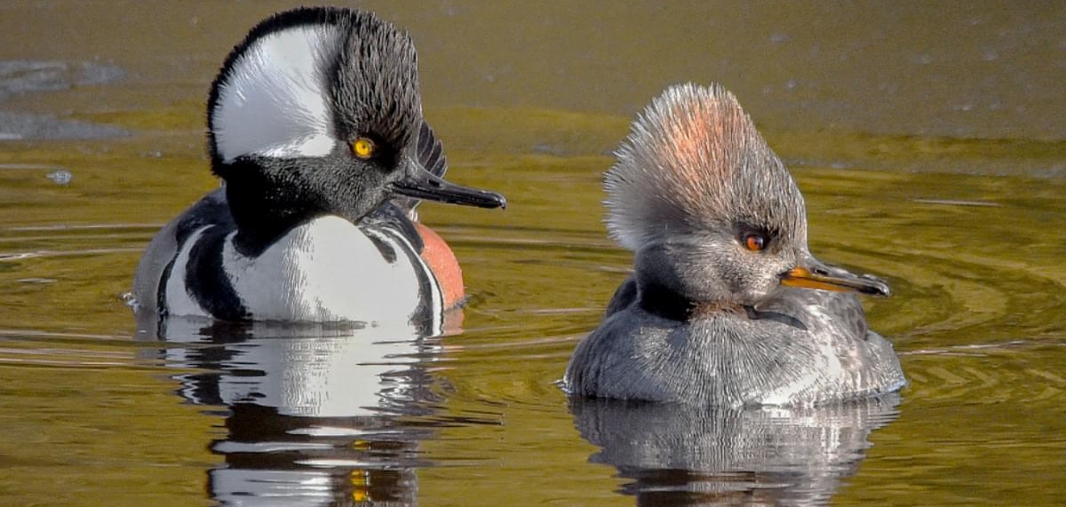
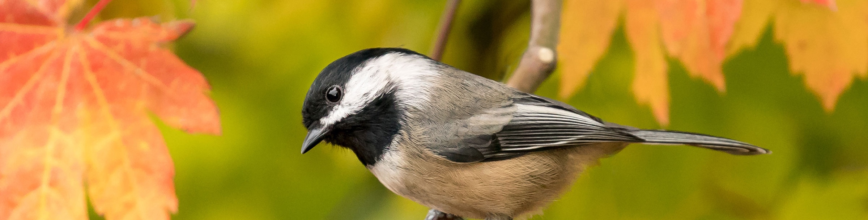
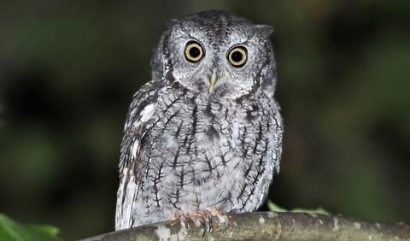
Let’s Learn About Birds!
Photo: Jason Major
Bird Safe Guelph: School Outreach Programs K-2
Photo: Mick Thompson
Photo: Dean Anderson

Slide 2
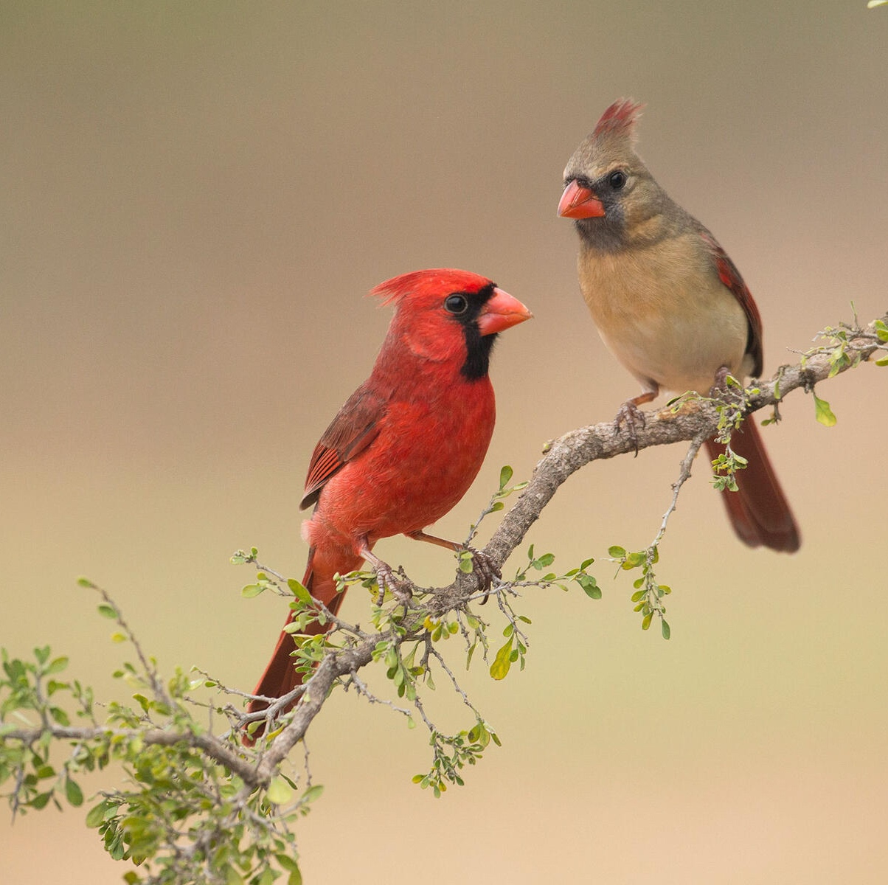
What are birds?
What words come to mind when you think of birds?
Northern Cardinal
Photo: Carole Wiley/Audubon

Slide 3

What are birds?
What are the 6 features that make a bird a bird?
Rock Pigeon
Art by Liz Clayton Fuller

Slide 4
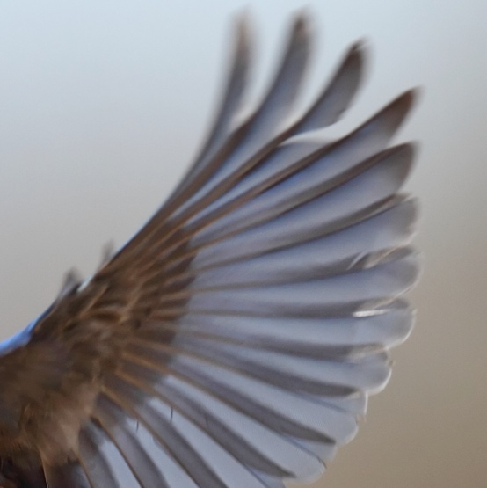
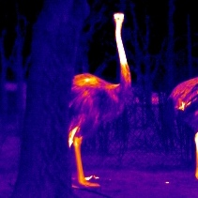
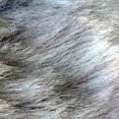
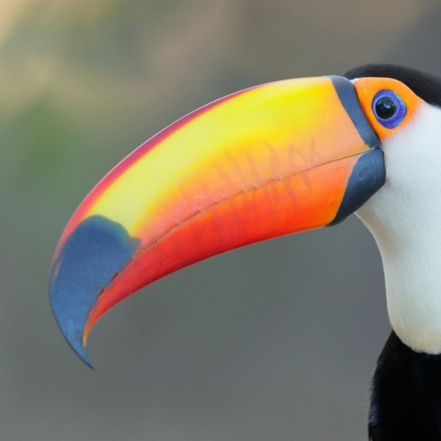
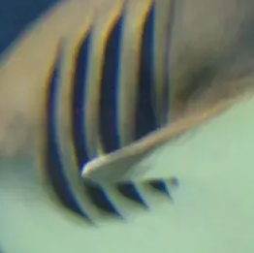
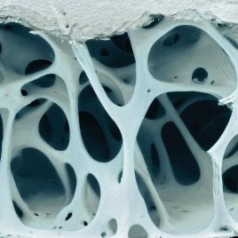
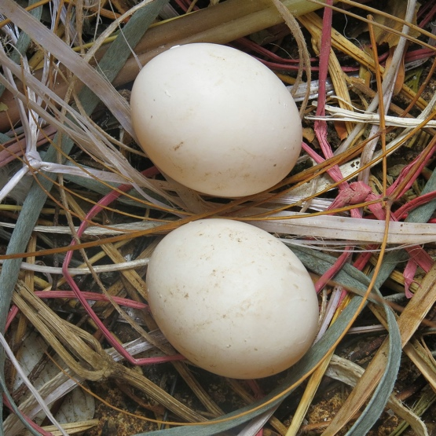


What are birds?
What are the 6 features that make a bird a bird?
Wings
Warm-blooded
Hair
Beaks
Gills
Lightweight Bones
Rock Pigeon
Art by Liz Clayton Fuller
Hard-shelled Eggs
Teeth
Feathers

Slide 5






What are birds?
What are the 6 features that make a bird a bird?
Wings
Warm-blooded
Hair
Beaks
Gills
Lightweight Bones
Rock Pigeon
Art by Liz Clayton Fuller
Hard-shelled Eggs
Teeth
Feathers

Slide 6
What are birds?
What are the 6 features that make a bird a bird?
Wings
Warm-blooded
Hair
For more bird anatomy check out:
All About Bird Anatomy
Beaks
Gills
Lightweight Bones
Rock Pigeon
Art by Liz Clayton Fuller
Hard-shelled Eggs
Teeth
Feathers

Slide 7
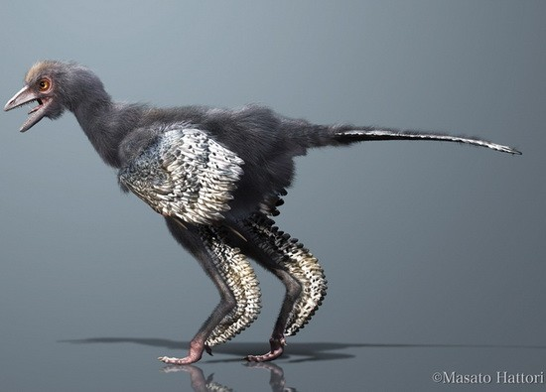
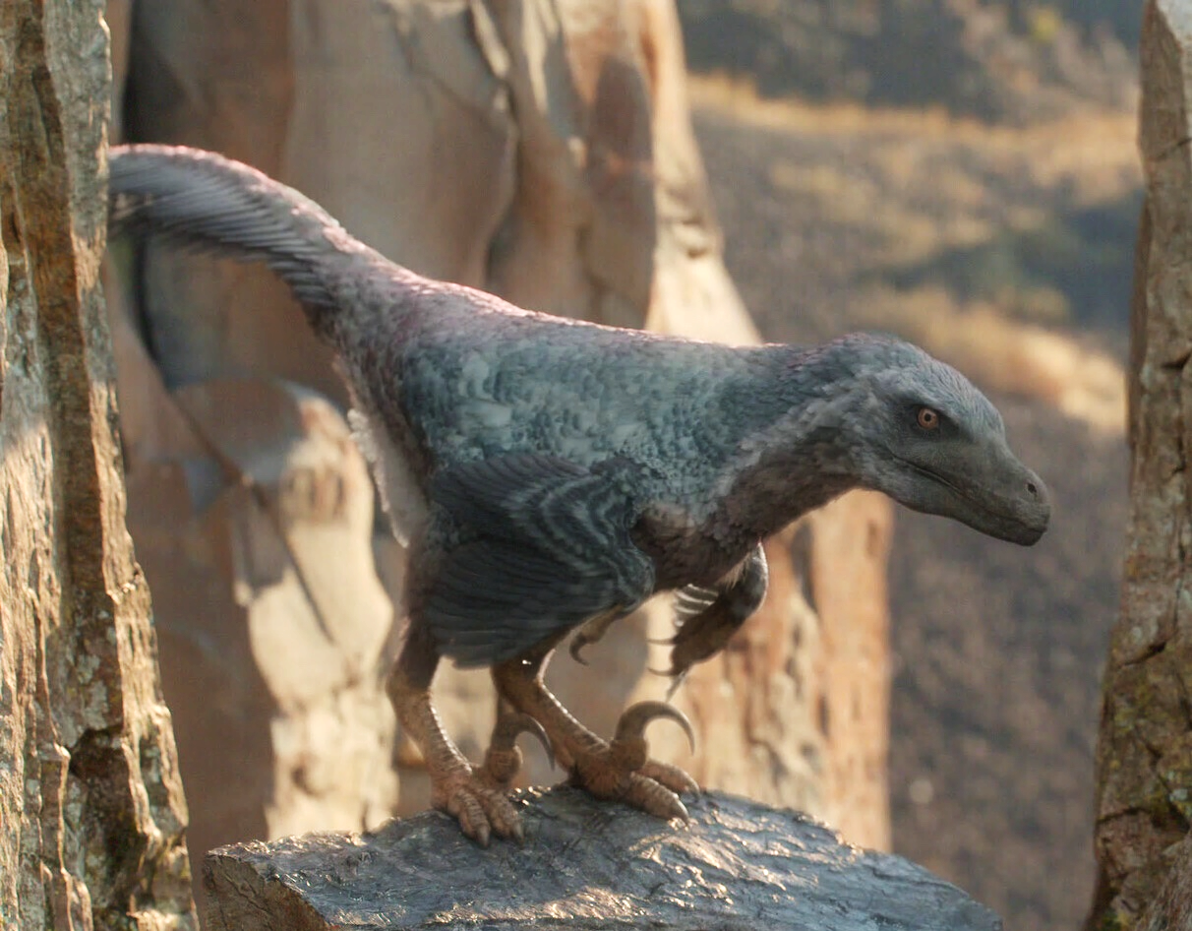
What are birds?
Birds are cool!
They’re actually feathered dinosaurs!
Evolved around 150 mya
  Earliest known bird is Aurornis xui
Aurornis xui
Art: Masato Hattori
Velociraptor mongoliensis
From: Prehistoric Planet
Notes:
Tyrannosaurus rex
Velociraptor mongoliensis

Slide 8
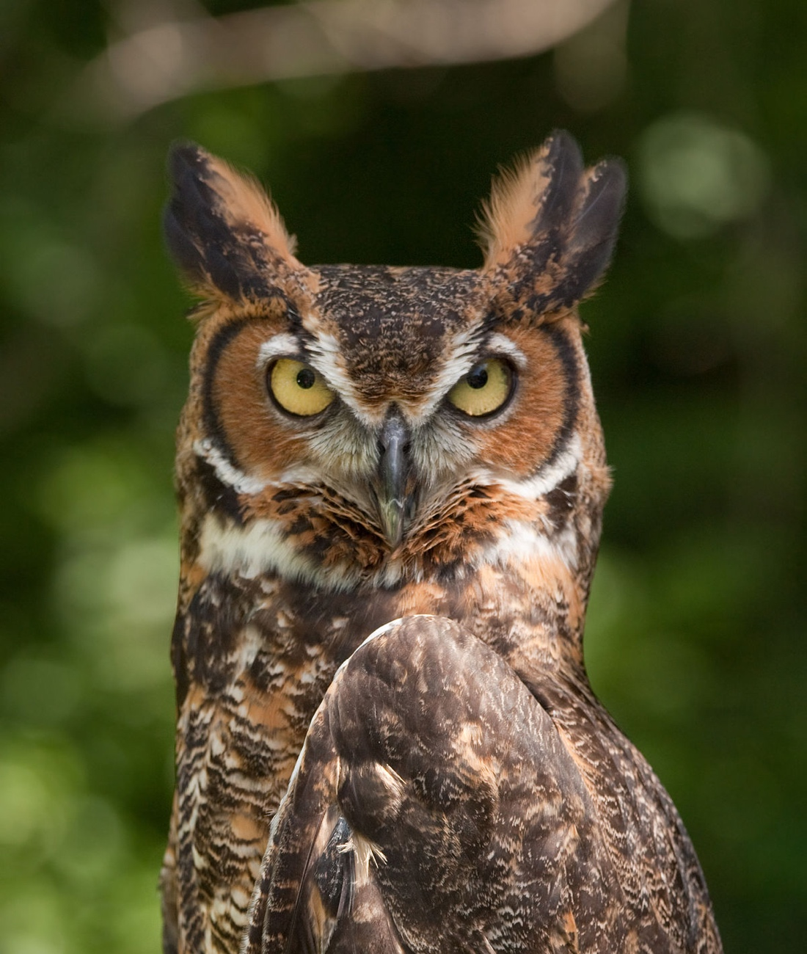
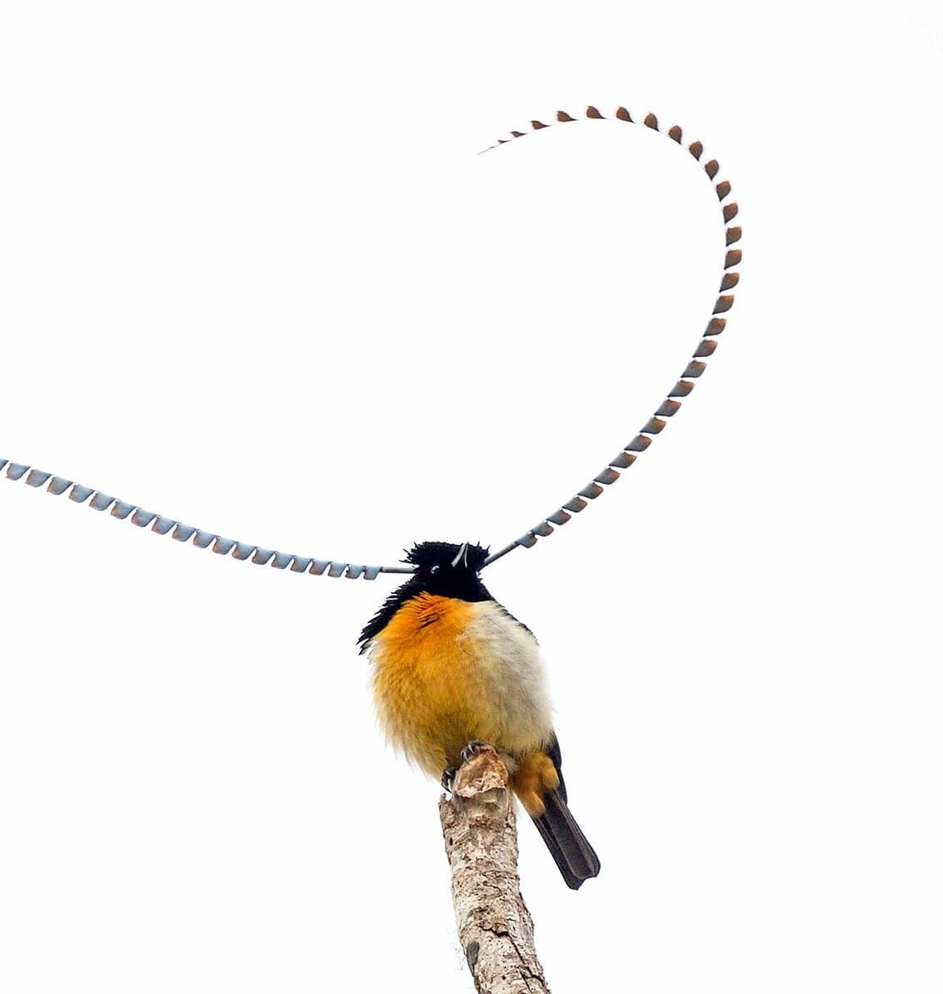
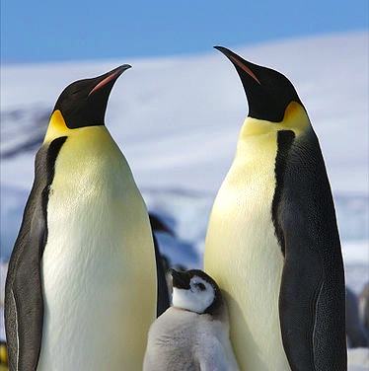
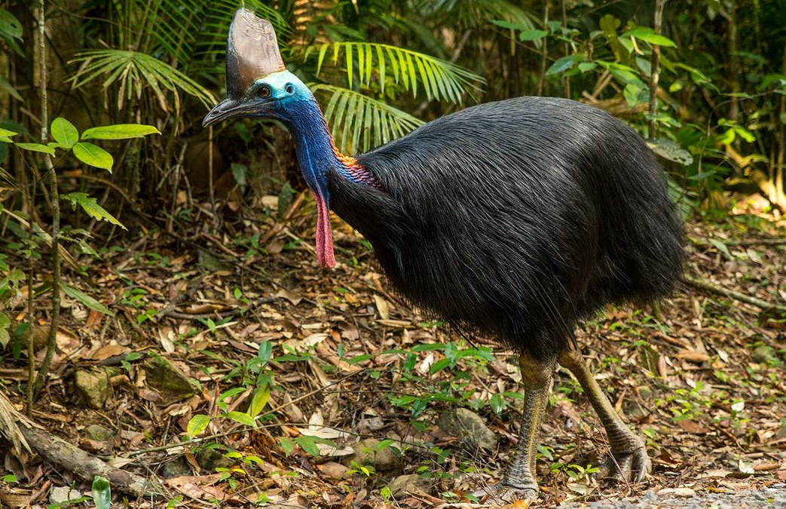
What are birds?
Great Horned Owl
Photo: Greg Hume
King of Saxony Bird of Paradise
Photo: Rich Lindie
Birds are diverse!
Emperor Penguins
Photo: Ian Duffy
Cassowary
Photo: Henry Cook/Getty Images

Slide 9
What are birds?
Great Horned Owl
Photo: Greg Hume
King of Saxony Bird of Paradise
Photo: Rich Lindie
Birds are diverse!
There are over 10,000 different species!
Emperor Penguins
Photo: Ian Duffy
Cassowary
Photo: Henry Cook/Getty Images

Slide 10
What are birds?
Great Horned Owl
Photo: Greg Hume
King of Saxony Bird of Paradise
Photo: Rich Lindie
Birds are diverse!
There are over 10,000 different species!
They are found on every continent
Emperor Penguins
Photo: Ian Duffy
Cassowary
Photo: Henry Cook/Getty Images

Slide 11
What are birds?
Great Horned Owl
Photo: Greg Hume
King of Saxony Bird of Paradise
Photo: Rich Lindie
Birds are diverse!
There are over 10,000 different species!
They are found on every continent
What are some birds that you have seen?
Emperor Penguins
Photo: Ian Duffy
Cassowary
Photo: Henry Cook/Getty Images

Slide 12
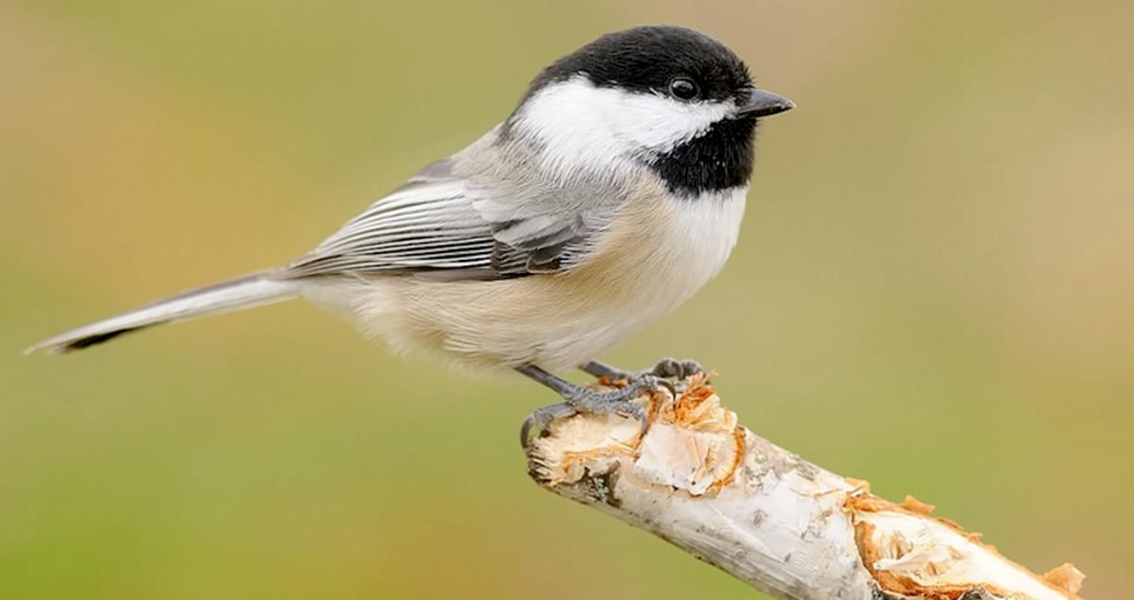

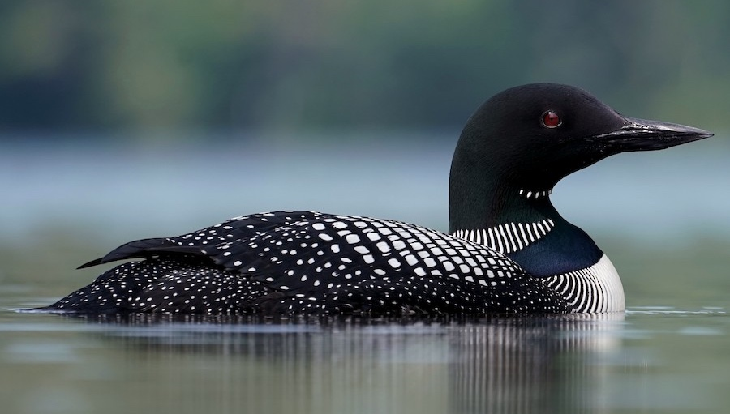

What are birds?
Birds are diverse!
There are over 10,000 different species!
They are found on every continent
What are some birds that you have seen?
Black-capped Chickadee
Photo: Linda Petersen
Common Loon
Photo: Christian Hagenlocher
Notes:
Hopefully someone gets these ones, but can highlight that the chickadee is the official bird of Guelph, and the Loon is Ontario’s provincial bird

Slide 13
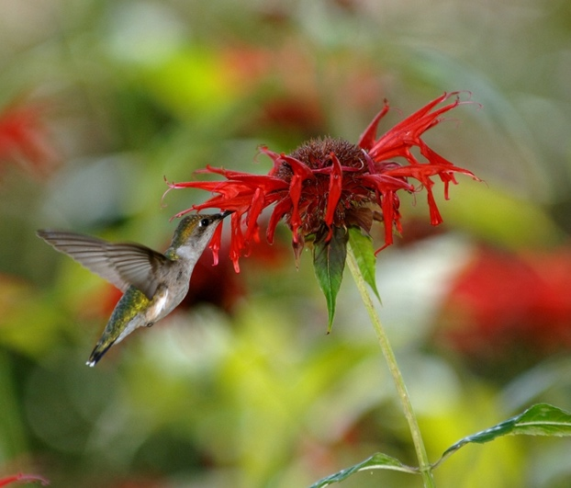
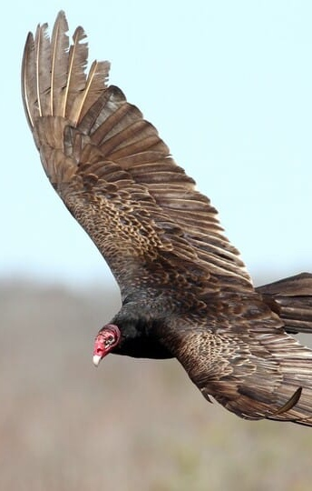
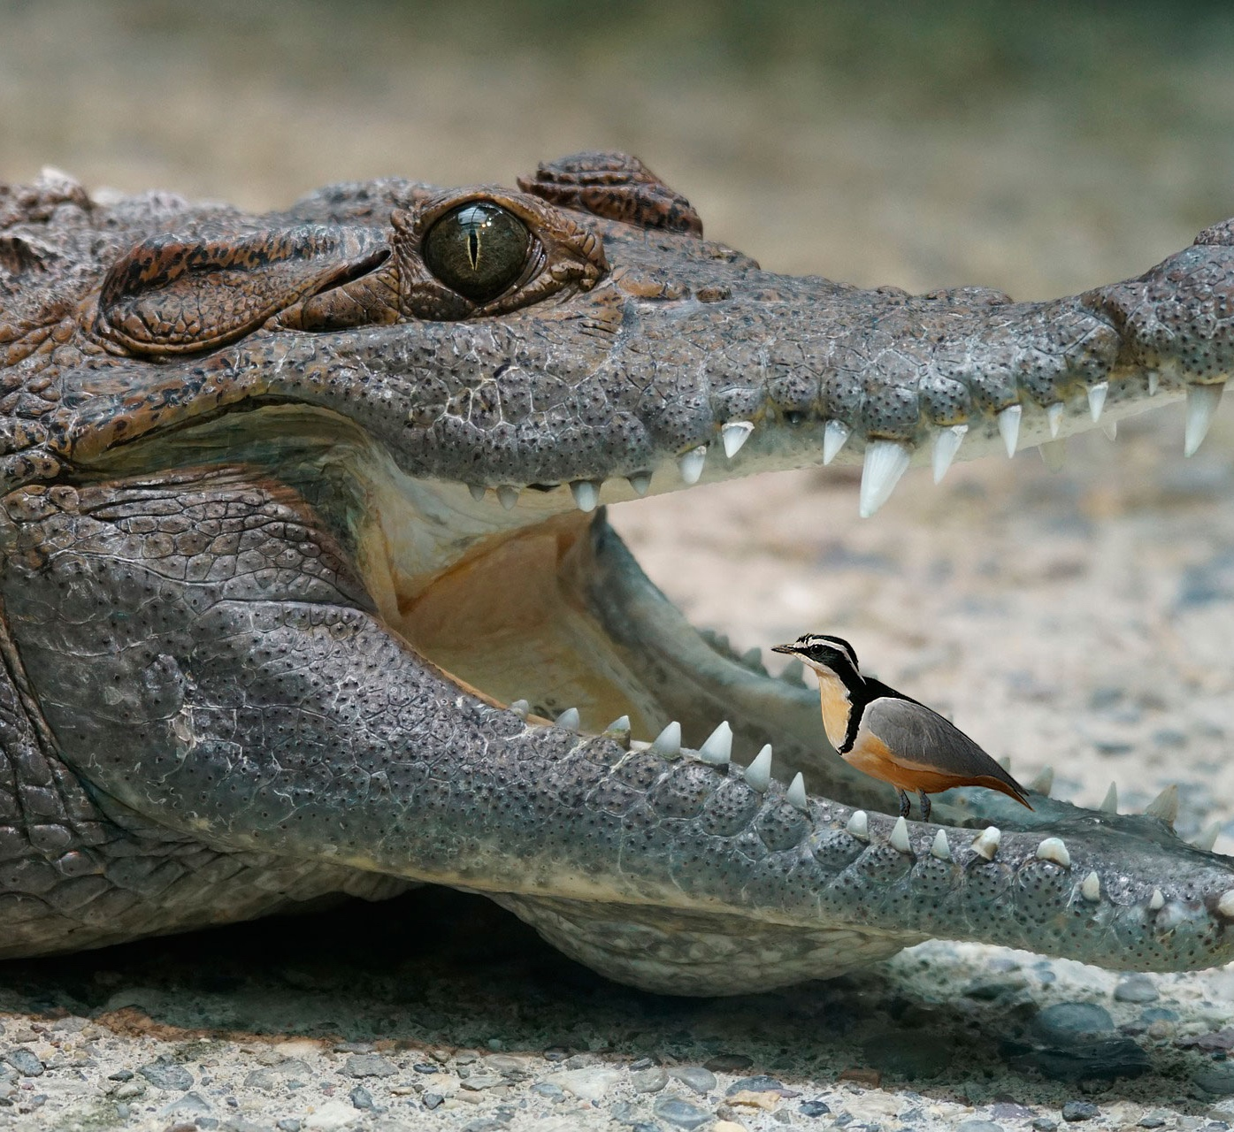
What are birds?
Ruby-throated Hummingbird
Photo: Joseph M. Schneid
Birds are important
Can you think of any reasons why?
Turkey Vulture
Photo: Evan Lipton
Egyptian Plover
https://smallscience.hbcse.tifr.res.in/crocodile-and-the-plover-bird/

Slide 14
What are birds?
Ruby-throated Hummingbird
Photo: Joseph M. Schneid
Birds are important
Can you think of any reasons why?
Ecosystem services
Pollination
  Ruby-throated Hummingbird
Scavengers
  Turkey Vulture
Interactions with other species
  Egyptian Plover and Nile Crocodile
Turkey Vulture
Photo: Evan Lipton
Egyptian Plover
https://smallscience.hbcse.tifr.res.in/crocodile-and-the-plover-bird/

Slide 15
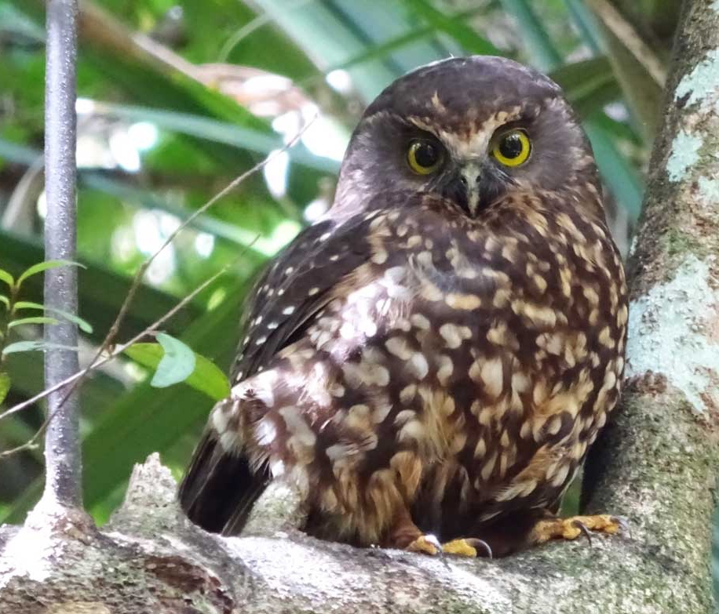
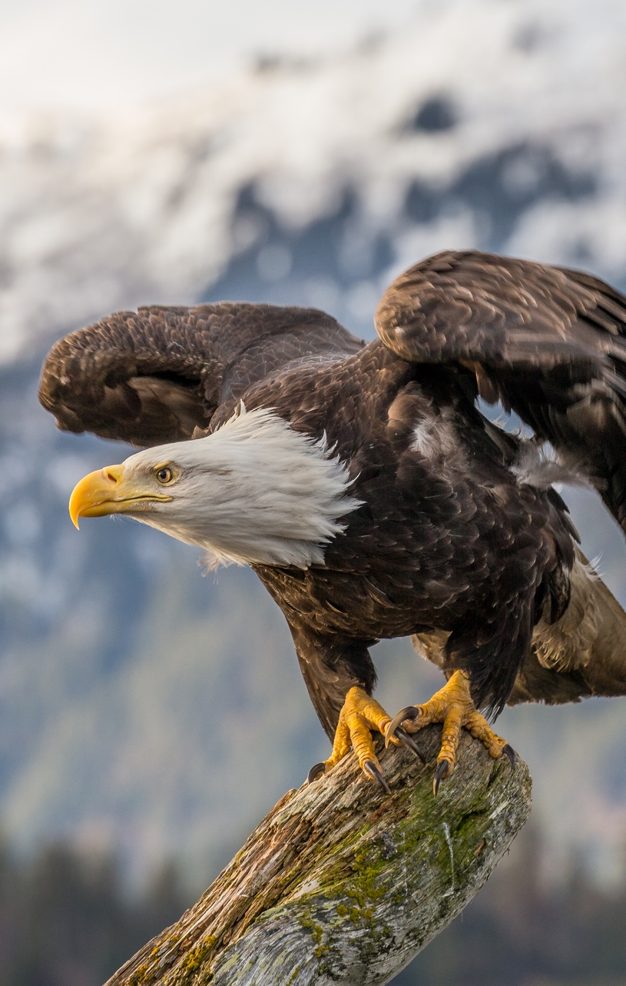
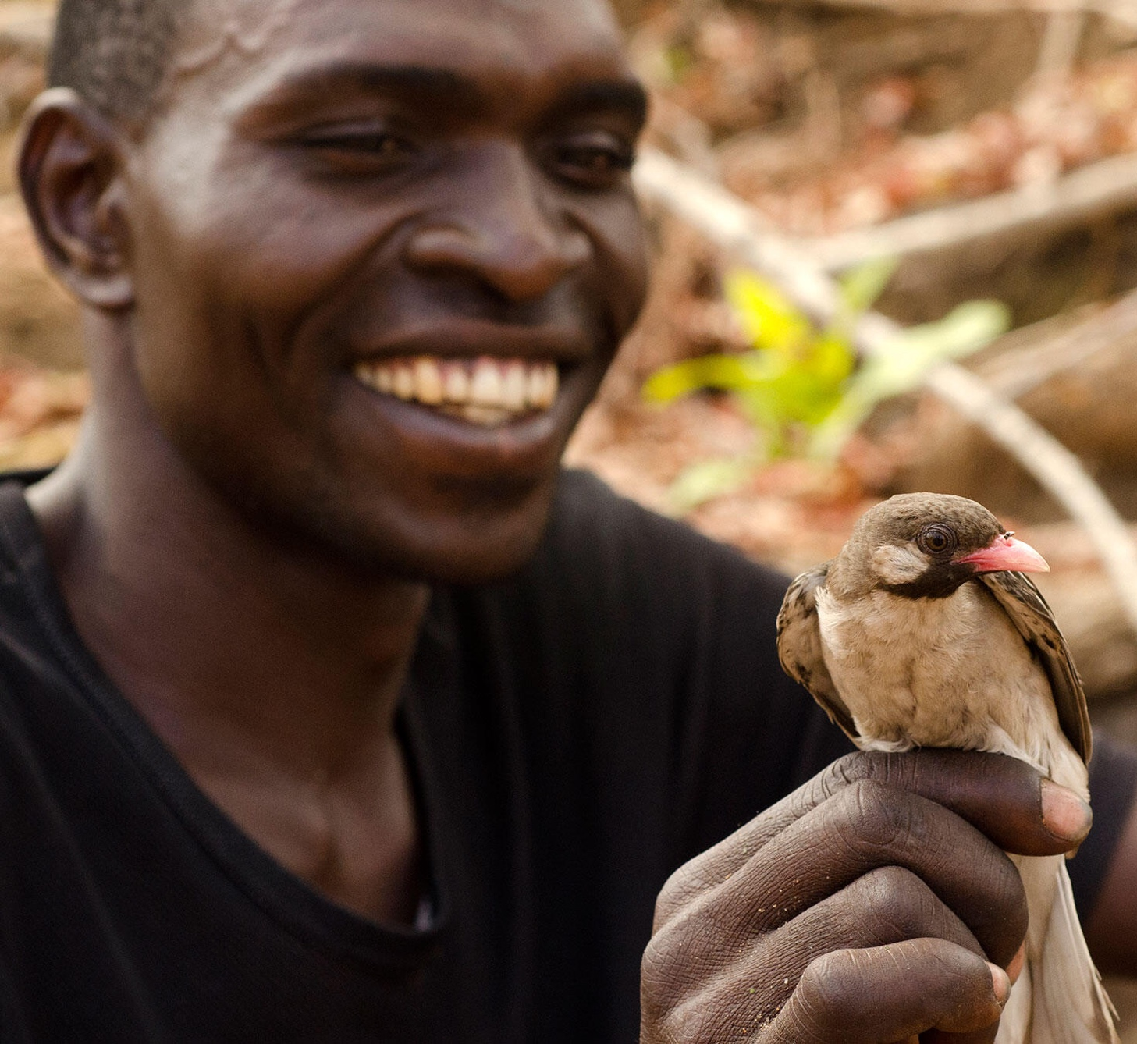
What are birds?
Ruru
Photo: Julie Mudge
Birds are important
Can you think of any reasons why?
Culturally Important
Ruru (Morepork) and Maori people
Bald Eagle and the United States
Greater Honeyguide and the Yao people
Bald Eagle
Photo: Andy Morffew
Greater Honeyguide
Photo: Claire Spottiswoode

Slide 16
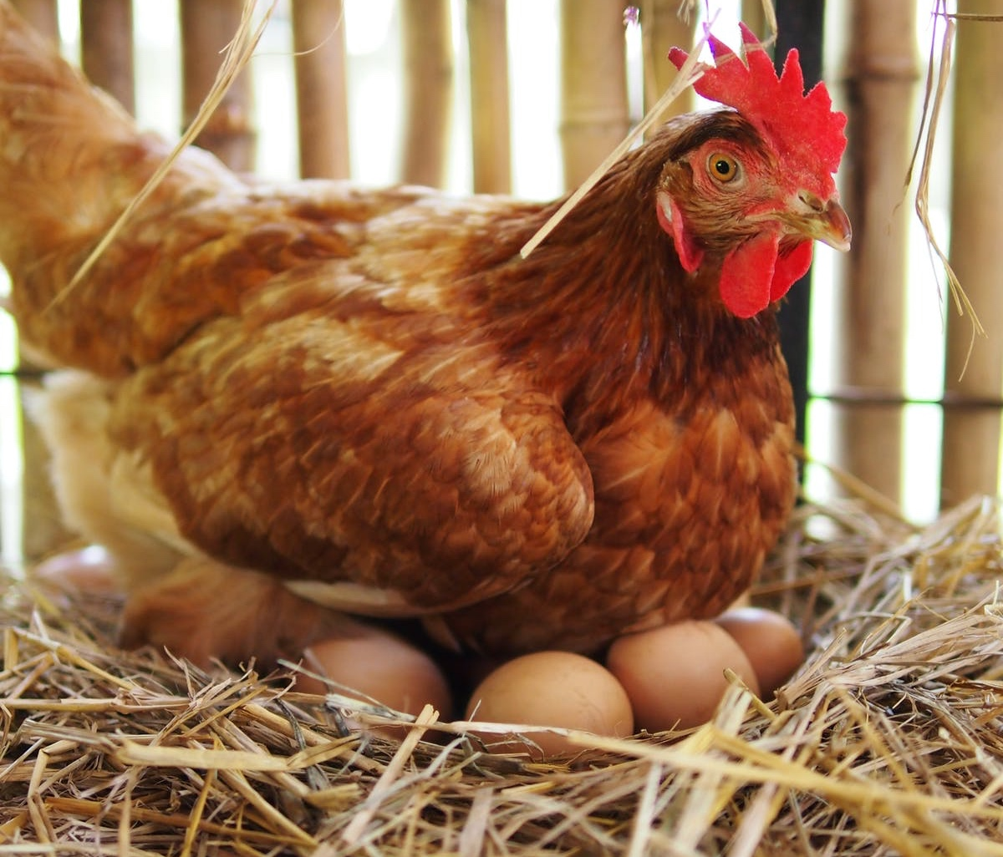

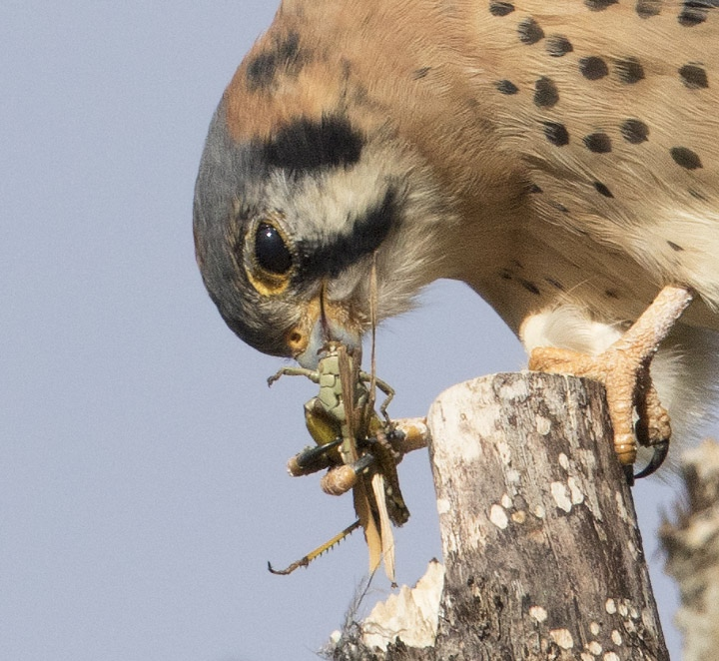
What are birds?
Chicken
https://starmilling.com/eggs-tasting-a-little-fishy/
Birds are important
Can you think of any reasons why?
Economically Important
Our Food
  Chicken eggs and meat
Agricultural Pest Control
  American Kestrel
Recreation
  Birdwatching!
Birdwatching!
Photo: CBC/Francis Ferland
American Kestrel
Photo: Ron Dudley

Slide 17
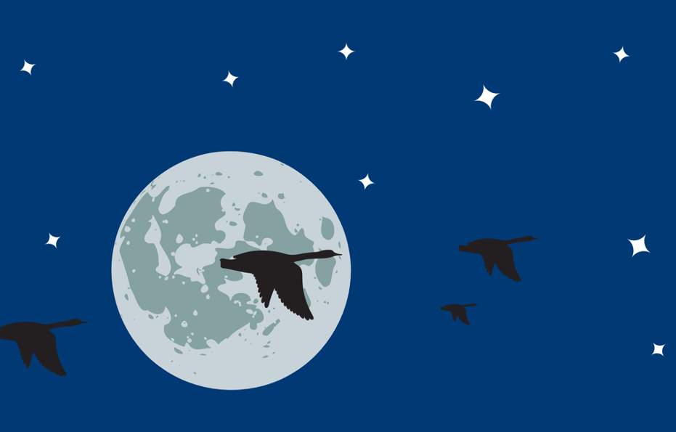

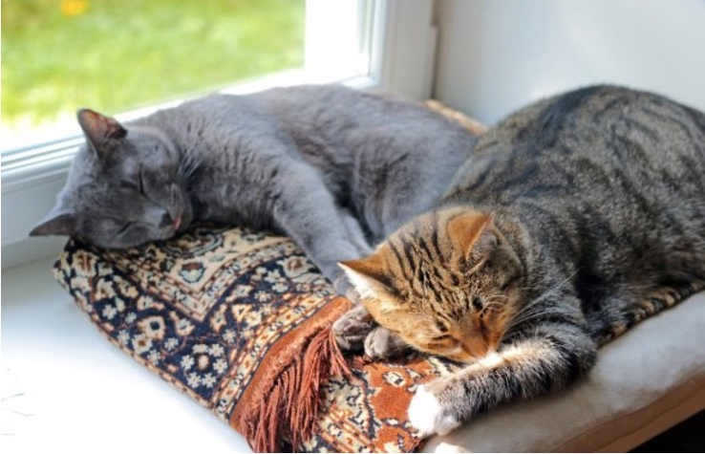
How can you help birds?
Bird-proof your windows!
  Prevents window collisions
  Visit FLAP to find out more
Turn off lights at night!
  Helps migrating birds
  Visit the Lights Out Program to learn how
Don’t let your cat outside!
  Cats are responsible for 4 billion bird deaths every year
https://blog.nwf.org/2017/09/11-tips-to-keep-your-indoor-cat-happy/

Slide 18
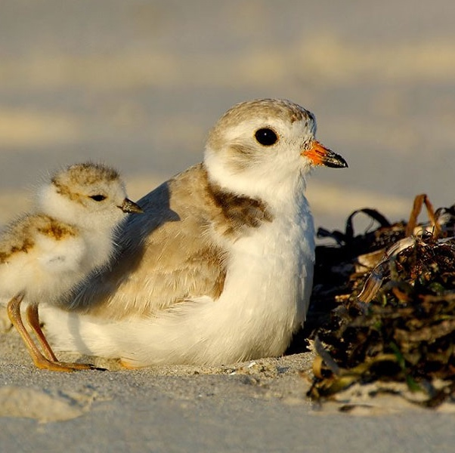
Piping Plover Game!
Your class is now a nesting colony of Piping Plovers!
You have a safe area where no dogs are aloud, but you all must venture out to find some yummy worms before the end of the season
Don’t let the dogs catch you before you collect 3 worms!
https://wildlifepreservation.ca/piping-plover/

Slide 19
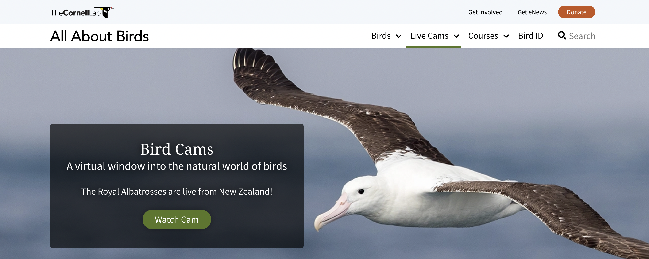
Let’s watch some birds!
Follow the link to the Cornell Lab of Ornithology’s Bird Cams to watch live video of birds all around the world!

